Slide 1
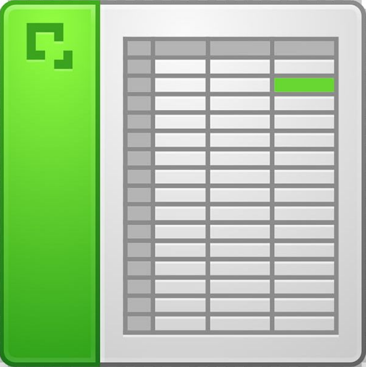
Spreadsheet Tools for Math
Learn how to build Microsoft Excel spreadsheets to create assessment questions for paper-and-pencil exams.
Spreadsheets include:
  A Quadratics spreadsheet that automatically graphs the function in a standard -10 to 10 window and displays the equation in Standard/Vertex/Factored form
  A 4th Degree Polynomial spreadsheet that converts from Factored Form to Standard Form
  …and more.
Pre-existing spreadsheets will be shared with all attendees.

Slide 2



Who is attending this presentation?
Experienced teachers who are interested in seeing the pre-built spreadsheets.
New teachers who would like any resources at all.
Teachers who love spreadsheets, and want to learn the skills to build their own.

Slide 3
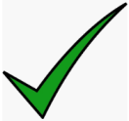
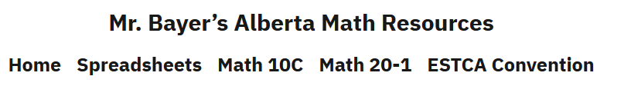
How do you benefit from attending?
Math 10C Resources
Math 20-1 Resources
Pre-built Spreadsheets
Building a Spreadsheet Demo
https://albertamathresources.school.blog/

Slide 4
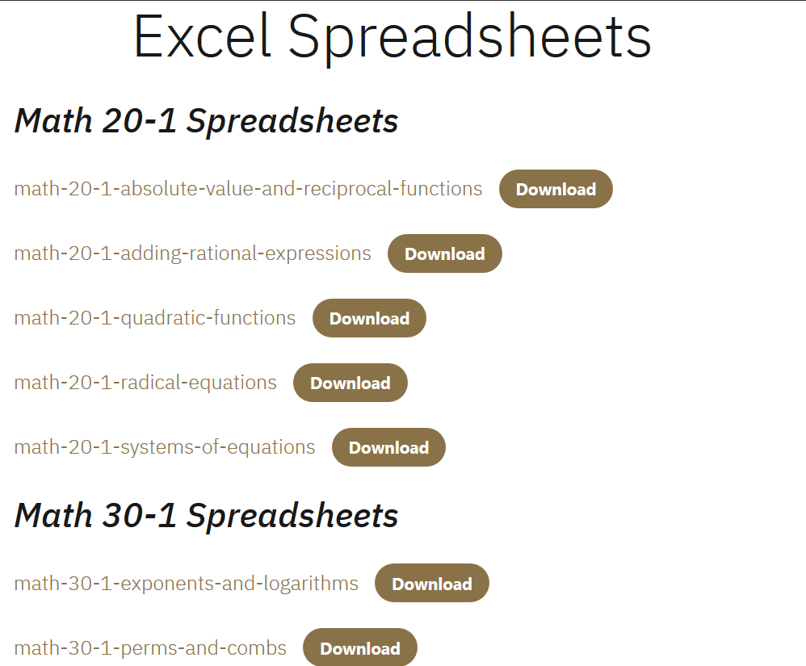


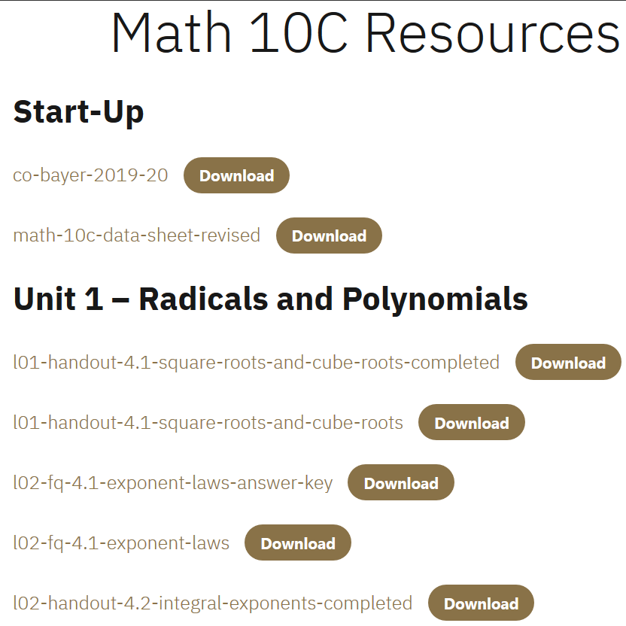
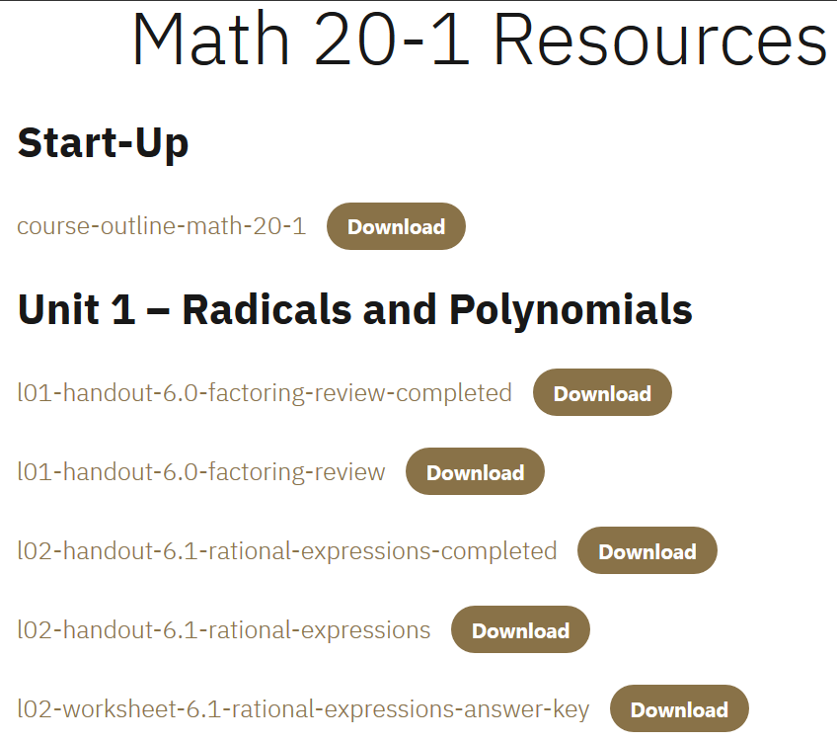
Today’s
Presentation:
Spreadsheet Tools
for Math

Slide 5
Part 1: Resources for New Teachers

Slide 6
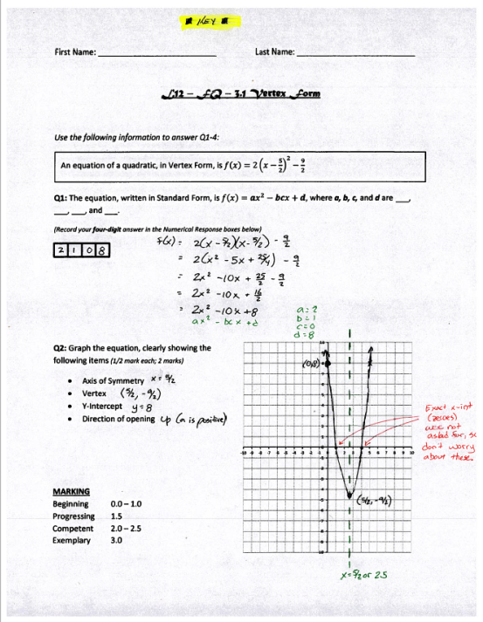
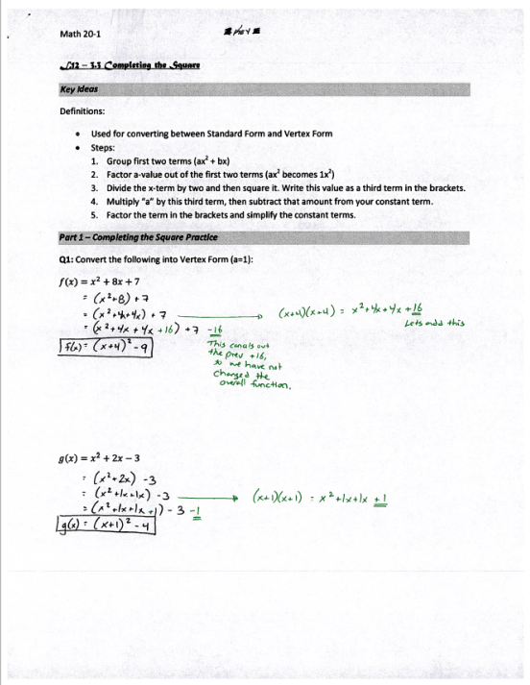
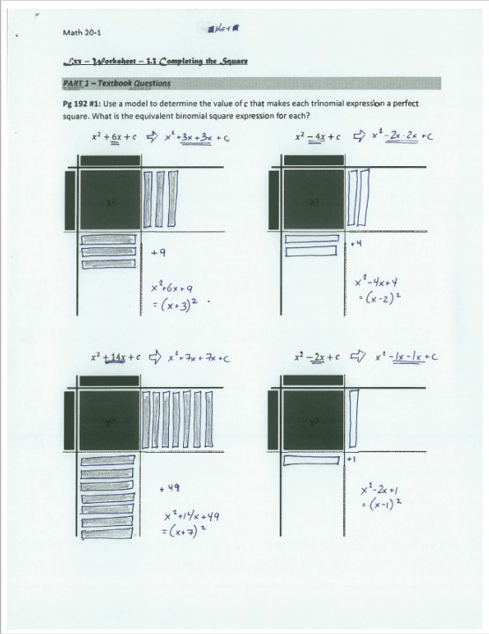
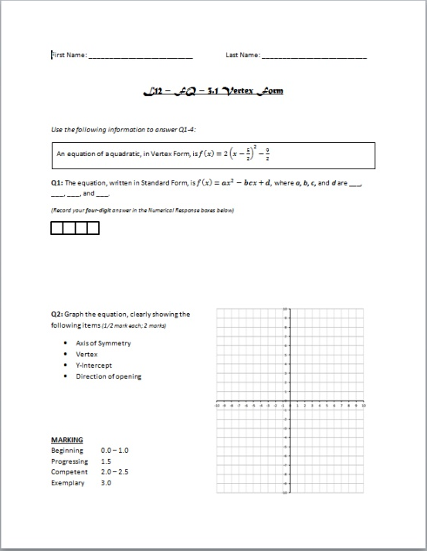
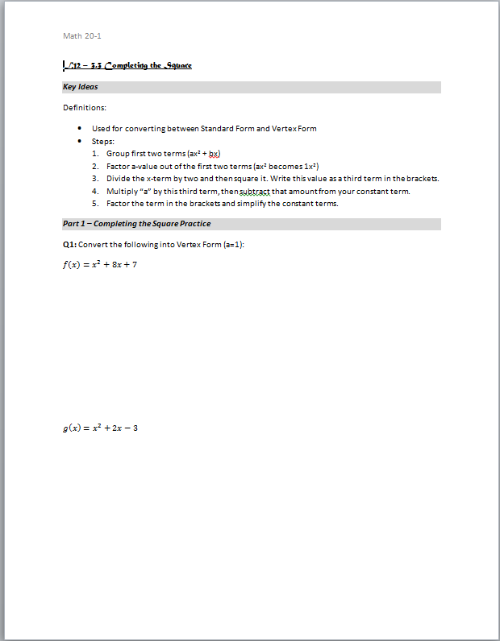
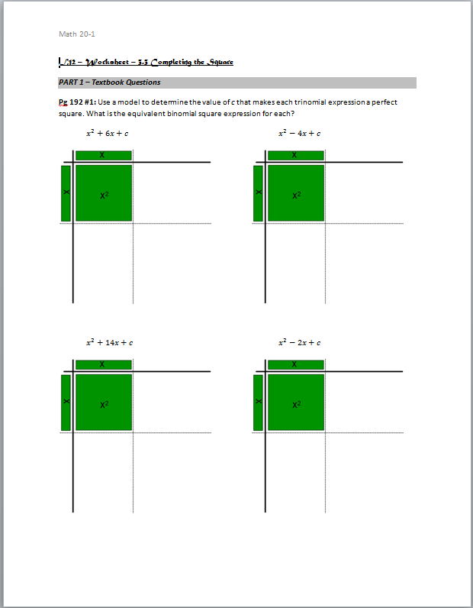
In Math 20-1, every file necessary for the 12th lesson has a “L12” prefix. In this case, there is a FQ (formative quiz), Handout, and Worksheet. All three have PDF’d answer keys.
L12 – FQ – 3.1 Vertex Form (Word)
and Answer Key (PDF)
L12 – Handout – 3.3 Completing the Square (Word)
and Answer Key (PDF)
L12 – Worksheet – 3.3 Completing the Square (Word)
and Answer Key (PDF)
Quick tour of Math 10C and Math 20-1 tabs on website

Slide 7
Part 2: Spreadsheets for Experienced Teachers

Slide 8
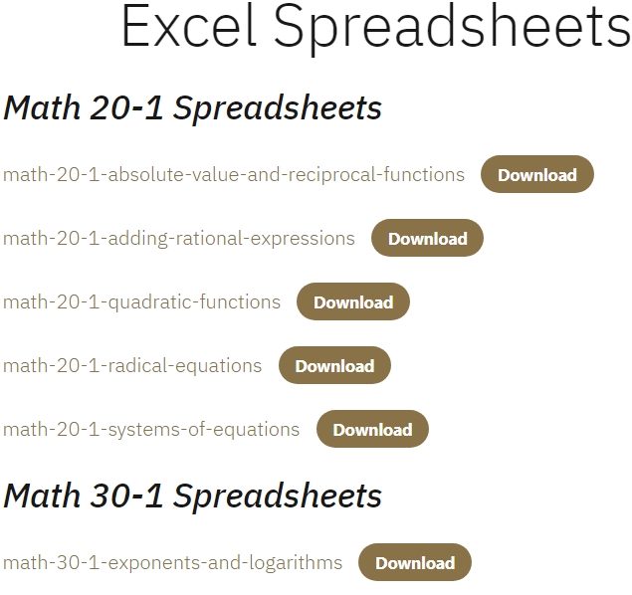
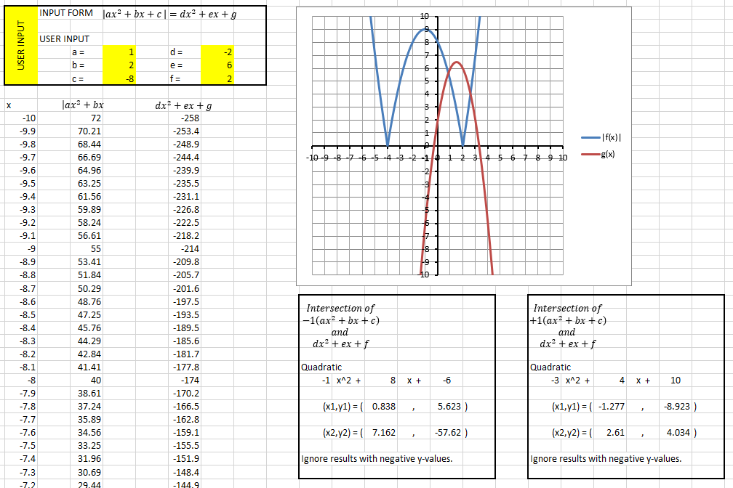
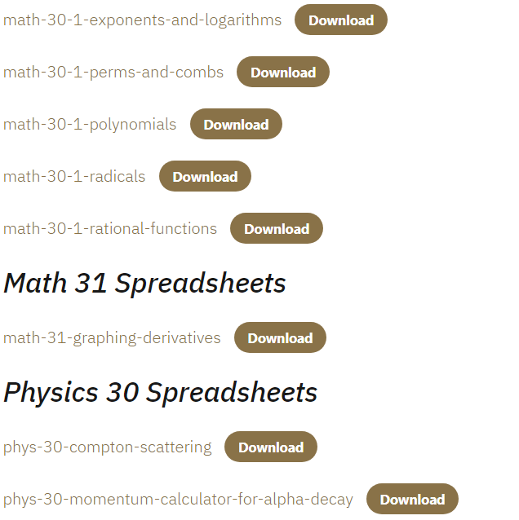
“Math 20-1 Absolute Value and Reciprocal Functions” spreadsheet, “Equations” tab.
Quick demo of Spreadsheets from the Spreadsheet tab of the website

Slide 9
Part 3: A Lesson for People that love Spreadsheets

Slide 10

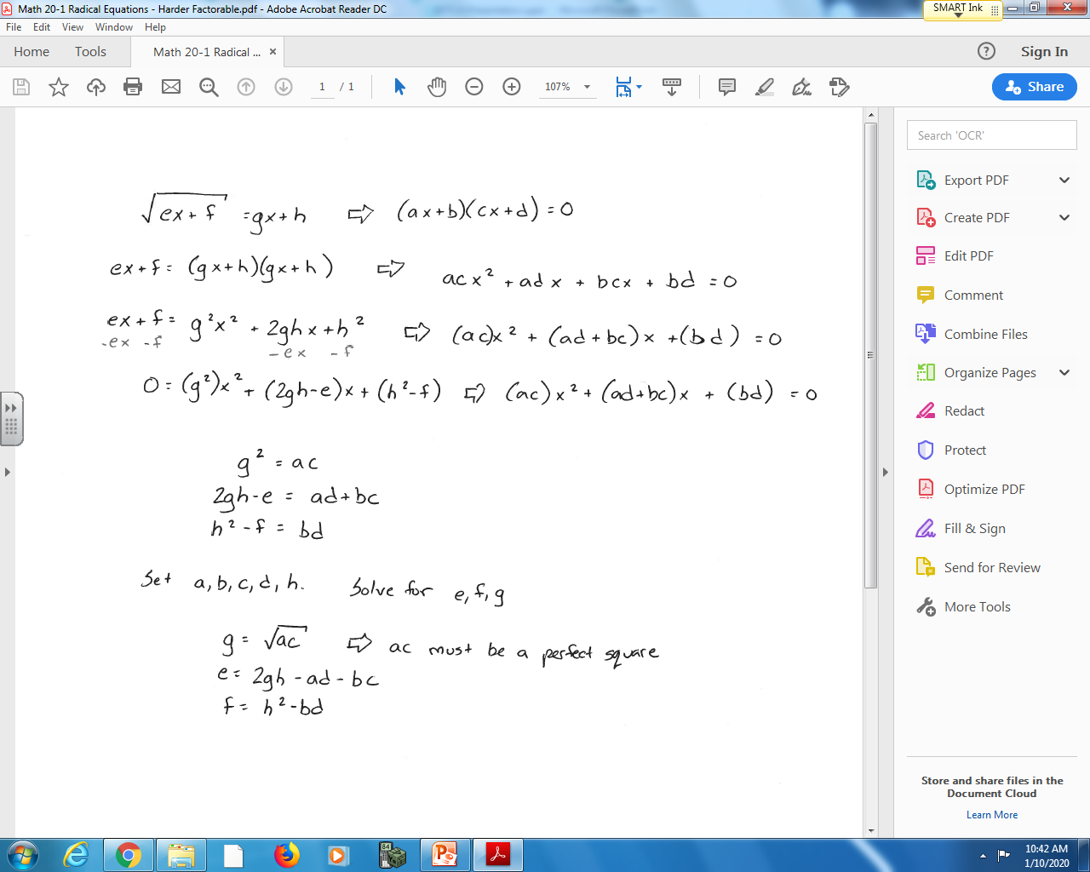
How would I create a spreadsheet that automatically builds factorable Radical Equations?
Set up a Radical Equation in the form that you wish to build…
…and set up the desired factored form.

Slide 11
“ESTCA Demo” spreadsheet, “Radical Equations Demo” tab.

Slide 12
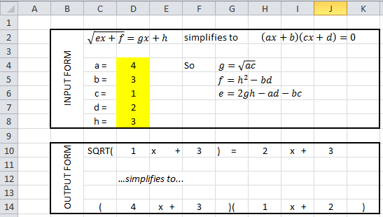
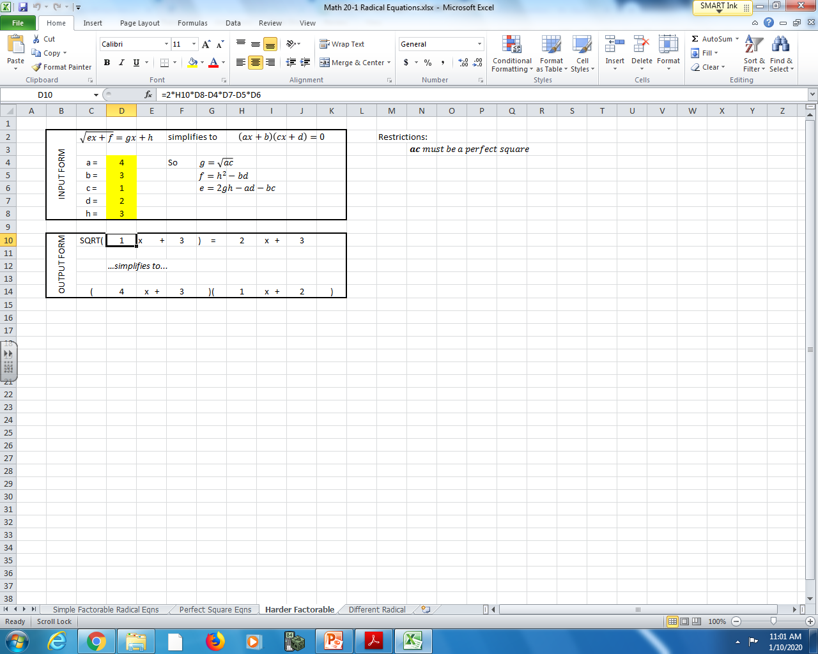
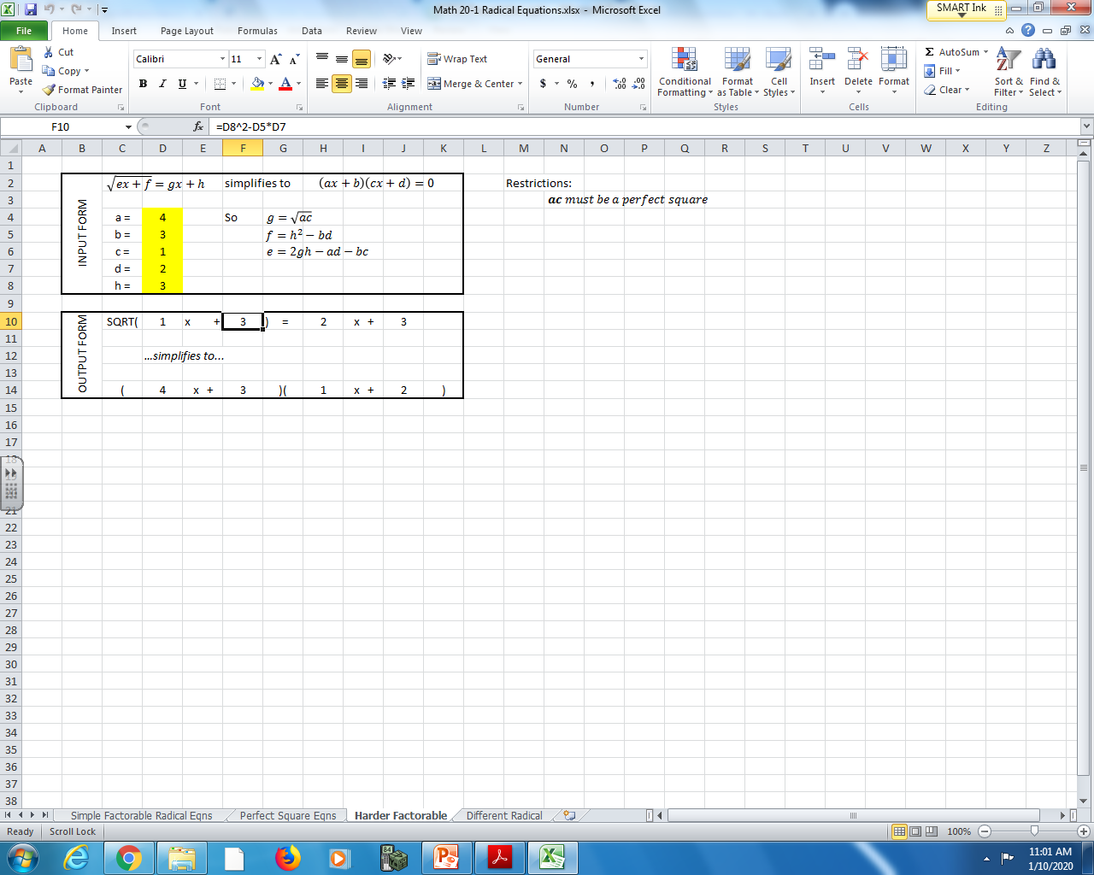
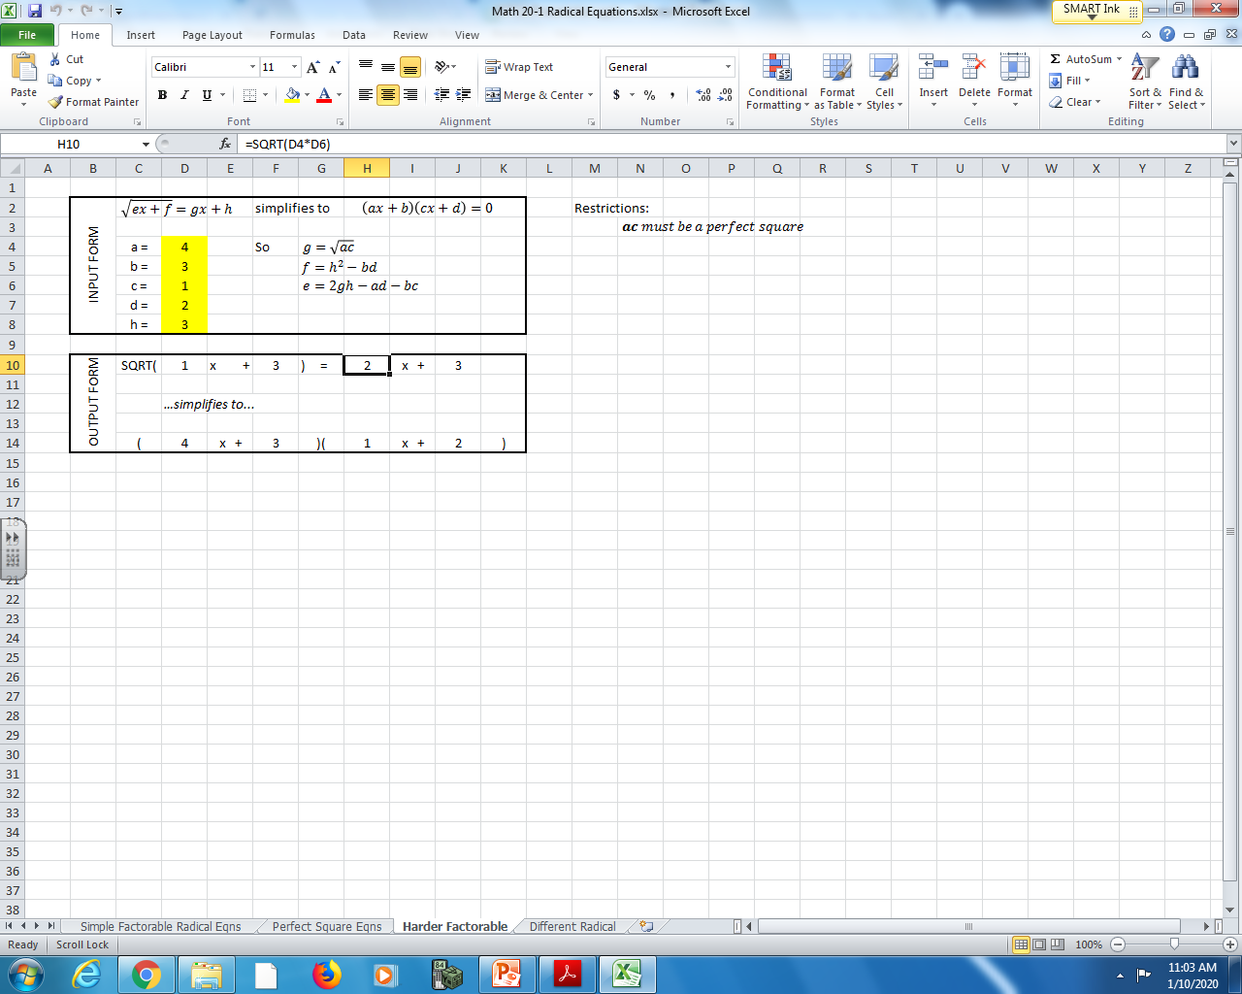
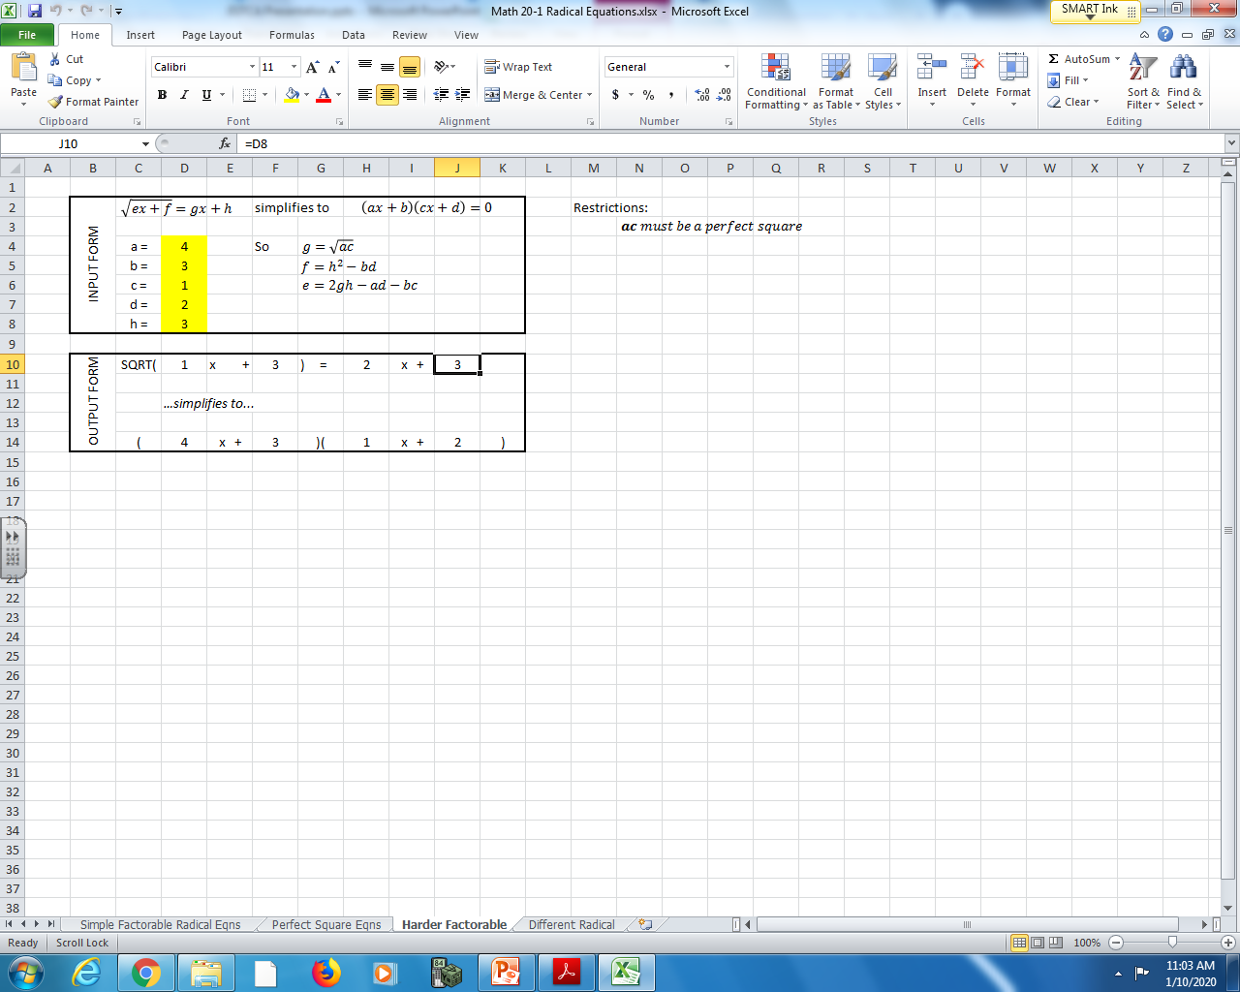
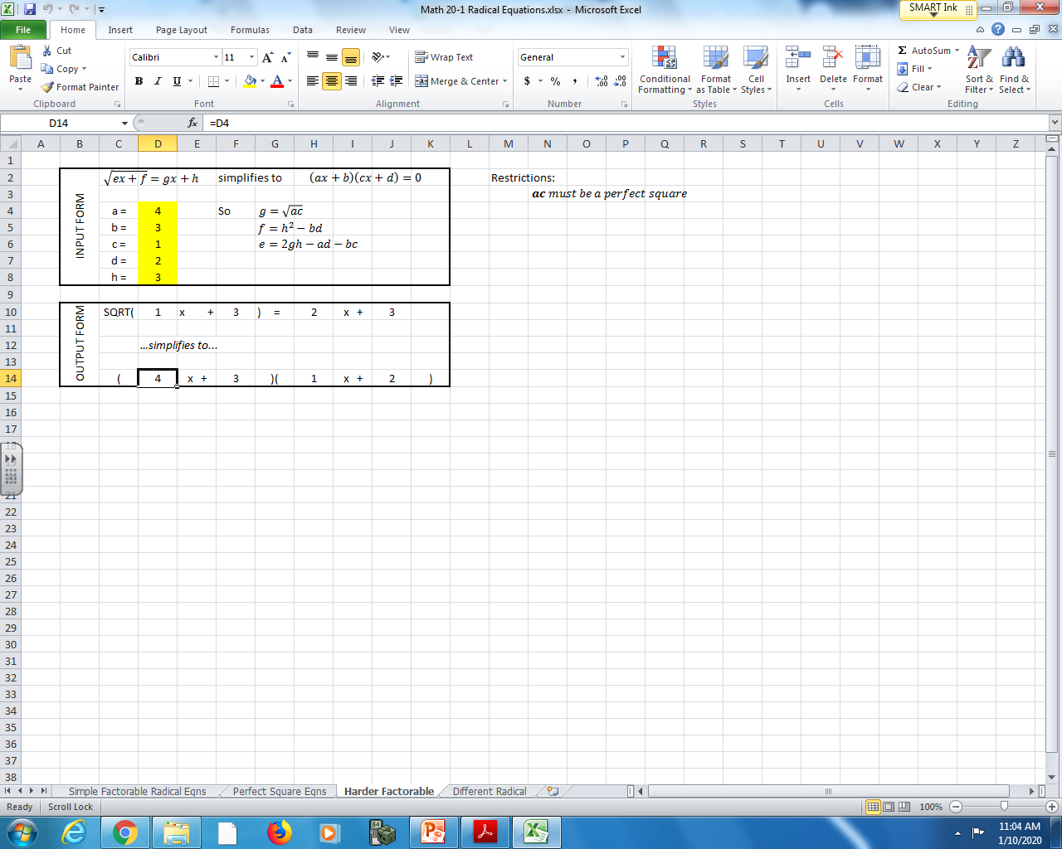

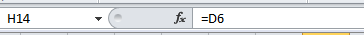
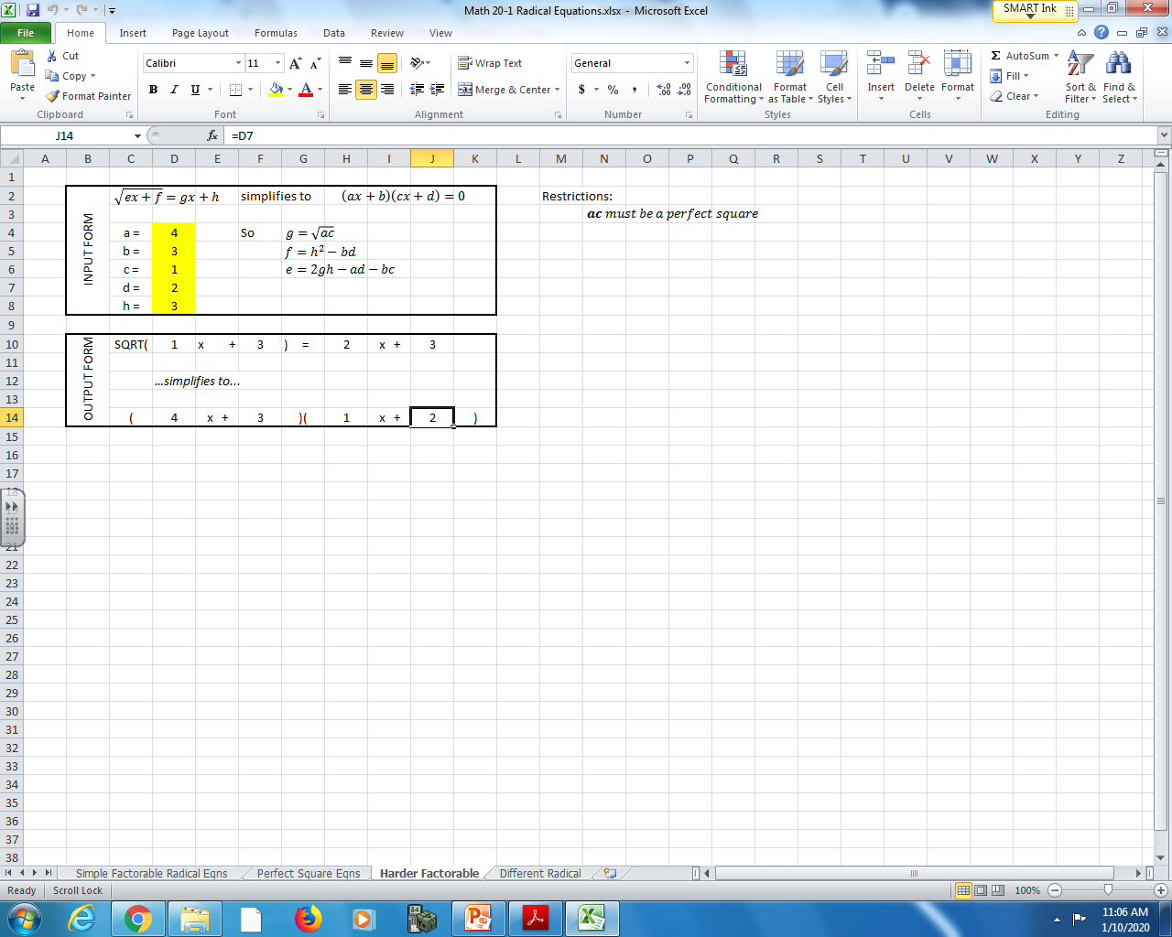
“ESTCA Demo” spreadsheet, “Radical Equations Demo” tab – ANSWER KEY
=2 * g * h– a * d – b * c
= h ^2- b * d
=SQRT( a * c )
= h
= a
= b
= c
= d
What does this look like in practice? See “Math 20-1 Radical Equations.xlsx”, then the “Harder Factorable” tab.

Slide 13


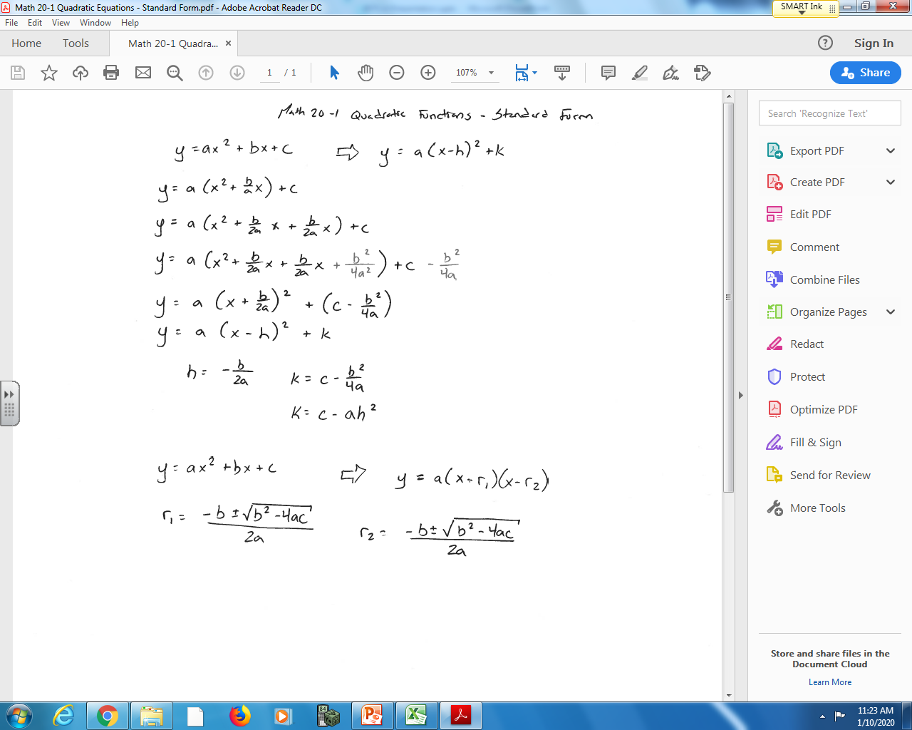
How would I create a spreadsheet that converts between forms of a Quadratic (Vertex, Standard, etc)?
Algebraically “complete the square” to determine the values of h, k.

Slide 14
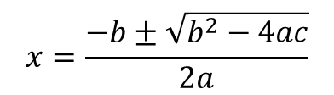
Convert to Vertex Form
Convert to Factored Form
$$x=\frac{−b±\sqrt{b^{2}−4ac}}{2a}$$
“ESTCA Demo” spreadsheet, “Quadratic Functions Demo” tab.

Slide 15
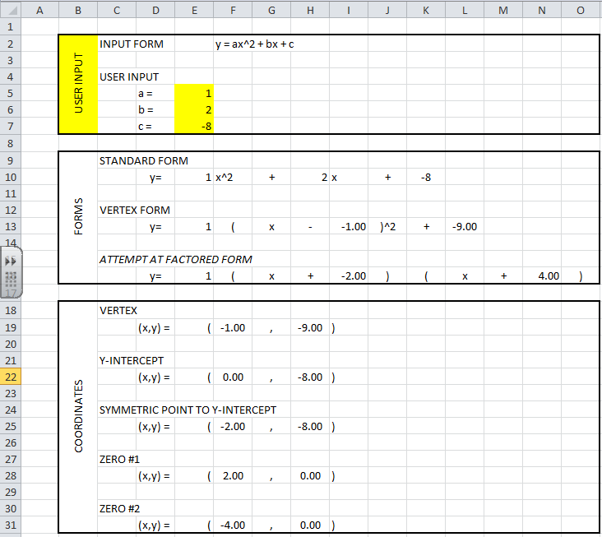
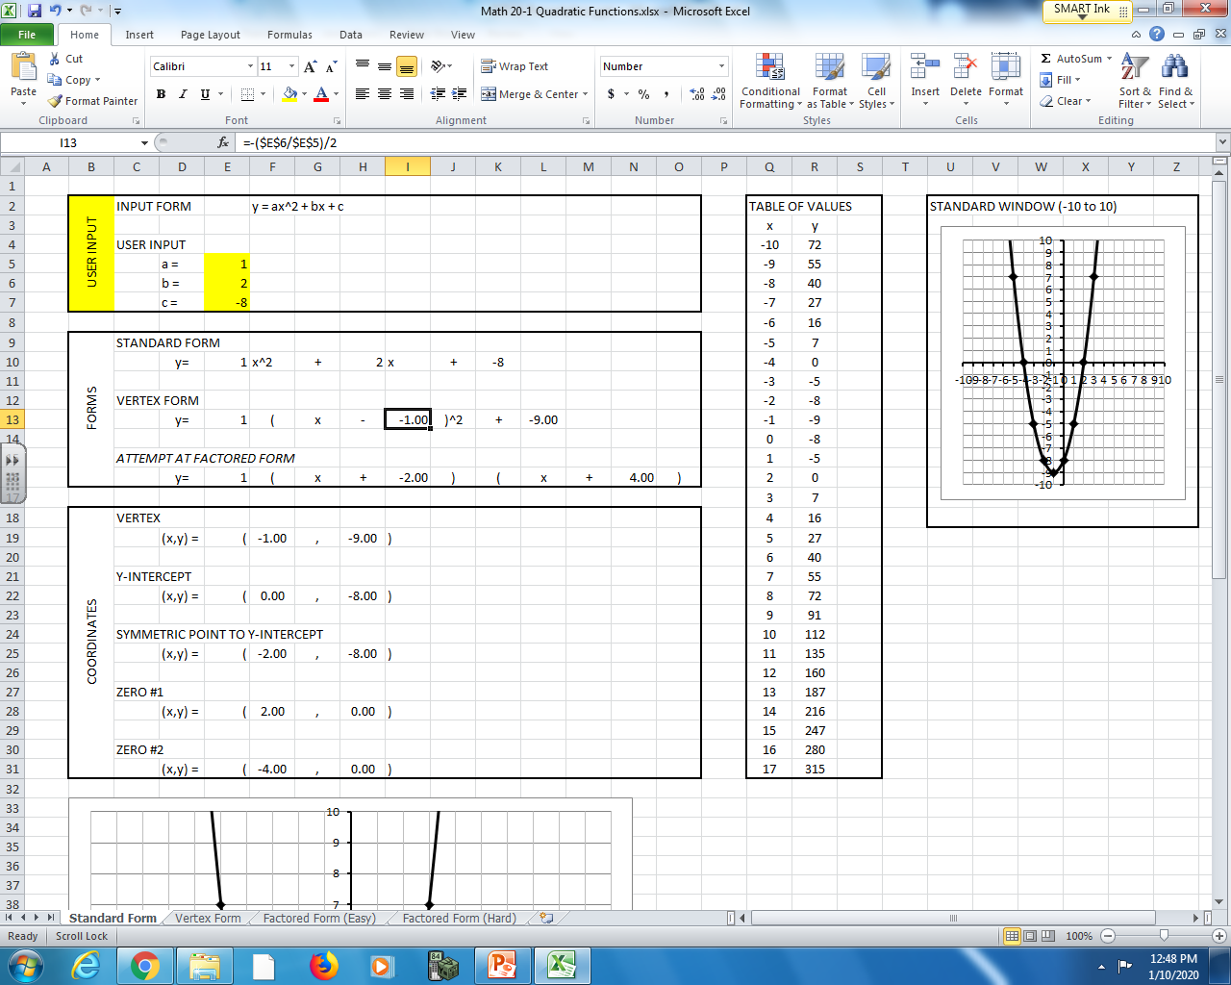
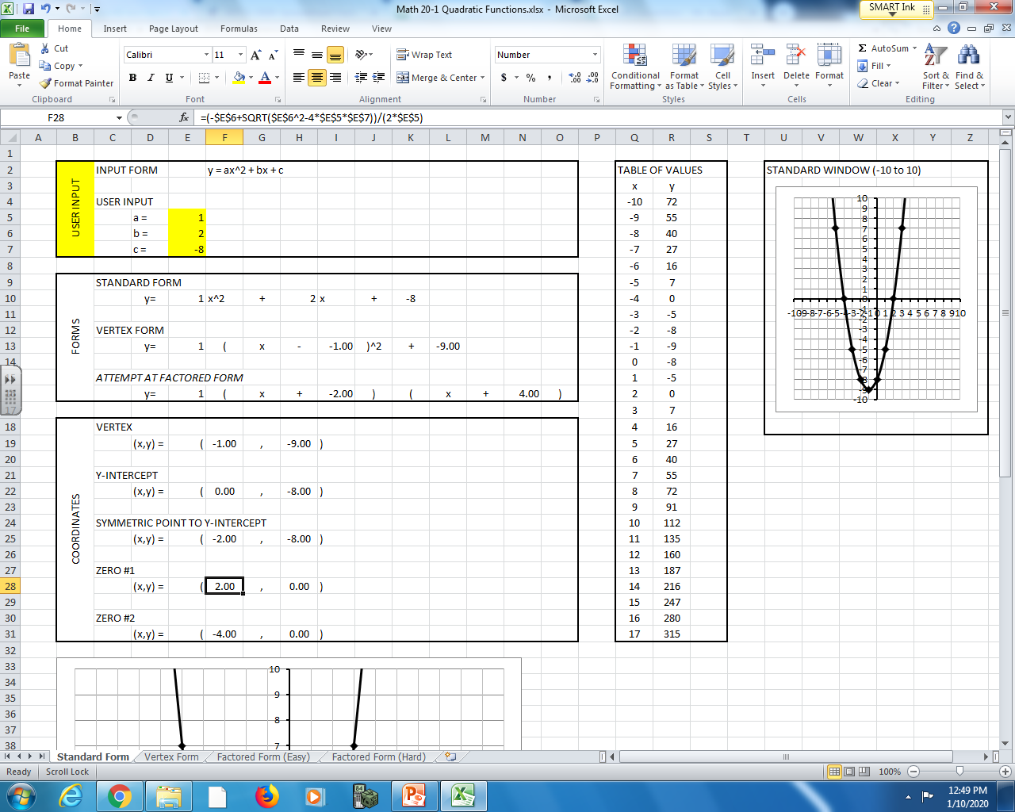
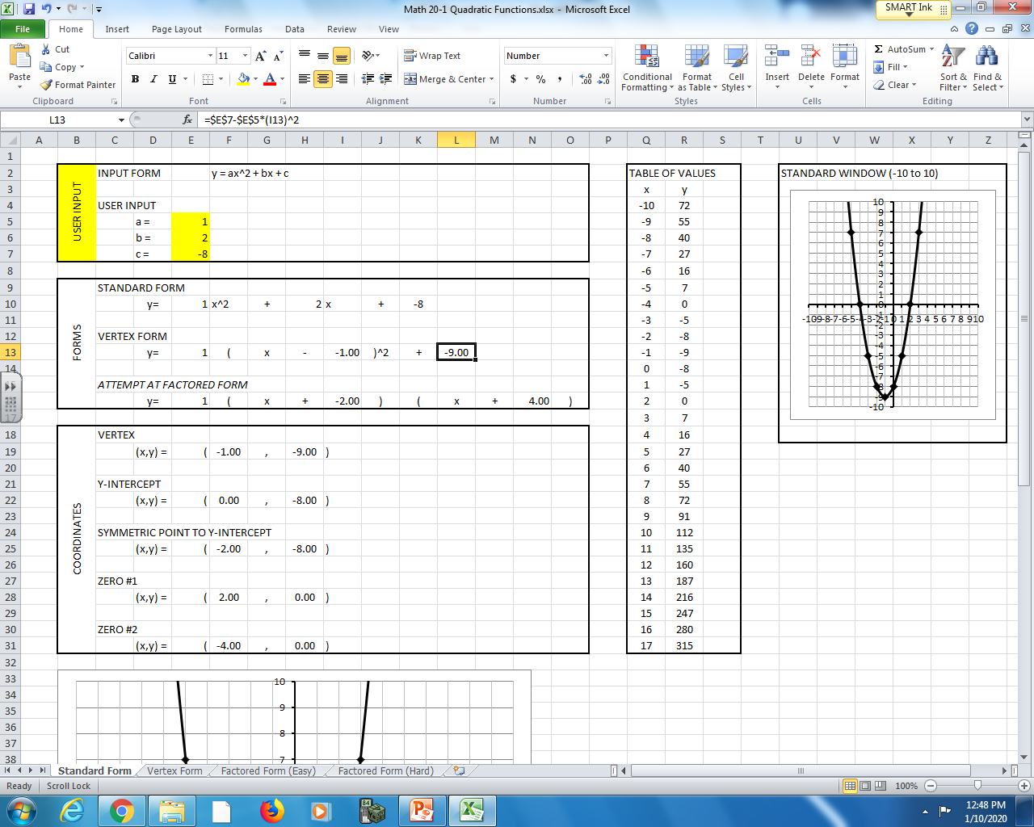
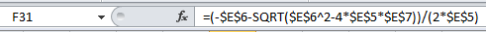
“ESTCA Demo” spreadsheet, “Quadratic Functions Demo” tab – ANSWER KEY
Vertex
Zeroes

Slide 16


Can we try building a Math 10C “Linear Systems” spreadsheet?
$$f\left(x\right)=ax+b intersects g\left(x\right)=cx+d at (e,f)$$
Option #1: Set point (e,f) and slopes a and c.
Solve for intercepts b and d.
Option #2: Set point (e,f) and intercepts b and d.
Solve for slopes a and c.
Option #3: Set both equations using a, b, c, and d.
Solve for intersection (e,f)
“ESTCA Demo” spreadsheet, “Linear Systems Demo” tab.

