Slide 1
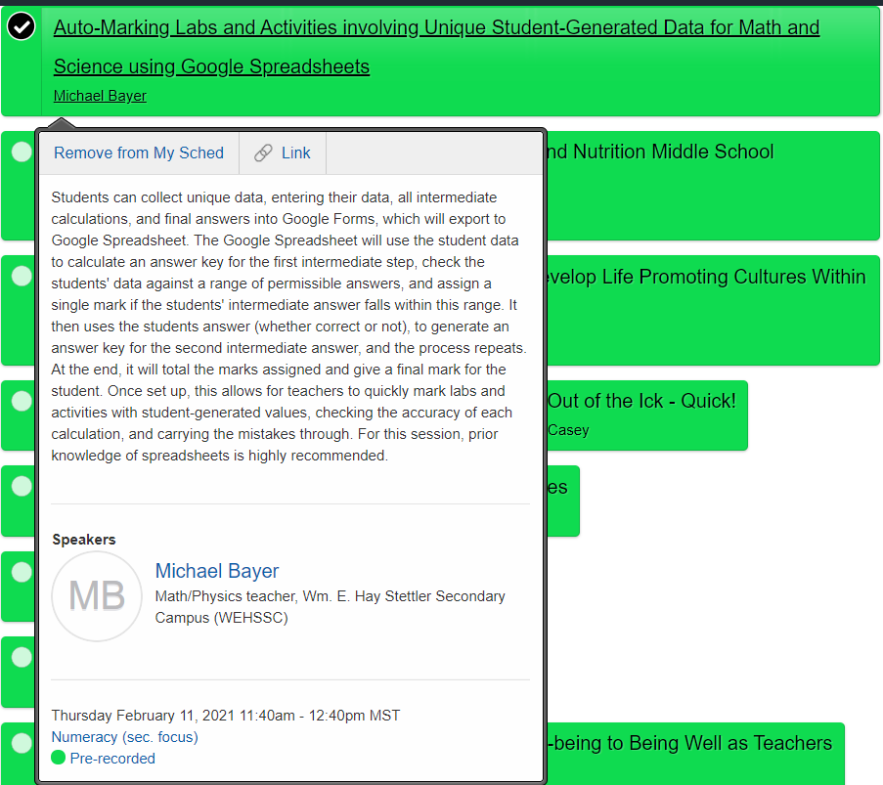
Auto-Marking Labs and Activities involving Unique Student-Generated Data for Math and Science using Google Spreadsheets
Free Goodies:
https://albertamathresources.school.blog/
Ma10C, Ma20-1, Ma20-2, Phys20, Phys30
ESTCA Presentations
Excel Sheets
Auto-Marking Labs and Activities:
Google Forms
Exporting to Google Spreadsheet
Setting up Auto-Marking Spreadsheet
“Auto-Marking” Student Submissions
Examples:
Initial Speed of a Throw
Momentum Cars
Step-by-Step Videos
Building Google Form
Building a Google Spreadsheet

Slide 2


Free Goodies:
https://albertamathresources.school.blog/
Ma10C, Ma20-1, Ma20-2, Phys20, Phys30
ESTCA Presentations
Excel Sheets

Slide 3
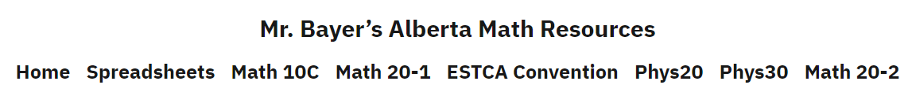
https://albertamathresources.school.blog/
Math 10C
Math 20-1
Phys20
Phys30
Math 20-2
Pre-built Excel sheets that can be used to build questions for Math 20-1, Math 30-1, and Physics 30
The subject of my 2019/2020 ESTCA presentation.
Copies of my 2019/2020 ESTCA presentation on Excel sheets.
Copies of my 2020/21 ESTCA presentation on Auto-Marking
Home
Spreadsheets
ESTCA Convention
And the rest of these are pre-built courses with Formative Quizzes (FQ), Handouts, and Worksheets. Each has completed PDF’s, so everything is already keyed.
Smart Notebook lessons and Summative Assessments are available upon request. Email mbayer@clearview.ab.ca for copies.

Slide 4

Auto-Marking Labs and Activities:
Google Forms
Exporting to Google Spreadsheet
Setting up Auto-Marking Spreadsheet
“Auto-Marking” Student Submissions

Slide 5
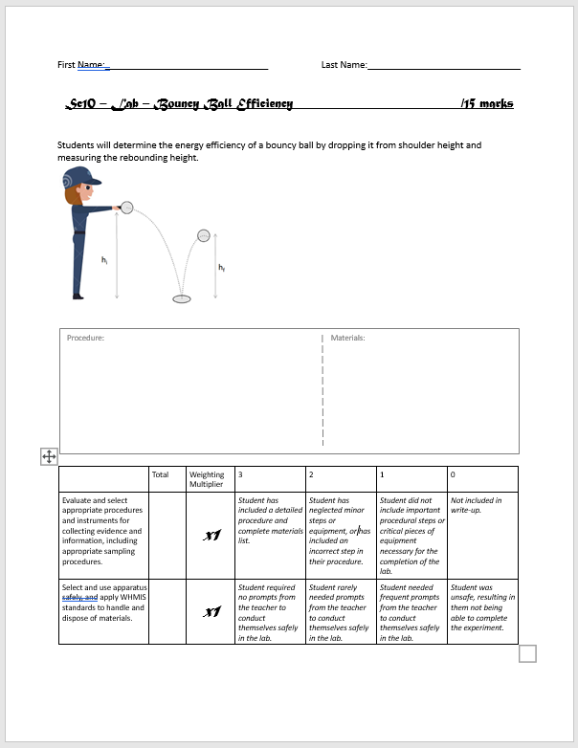
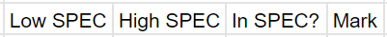






$$h_{i}$$
$$m$$
$$h_{f}$$
Simple calculations
$${Ep}_{i}=mgh_{i}$$
$${Ep}_{f}=mgh_{f}$$
Rounding or calculation errors affect answer at the next step.
$$Eff\left(\%\right)=\frac{Useful E_{out}}{Total E_{in}}x100\%$$
Solution? Range check every intermediate answer. Carry through mistakes.

Slide 6
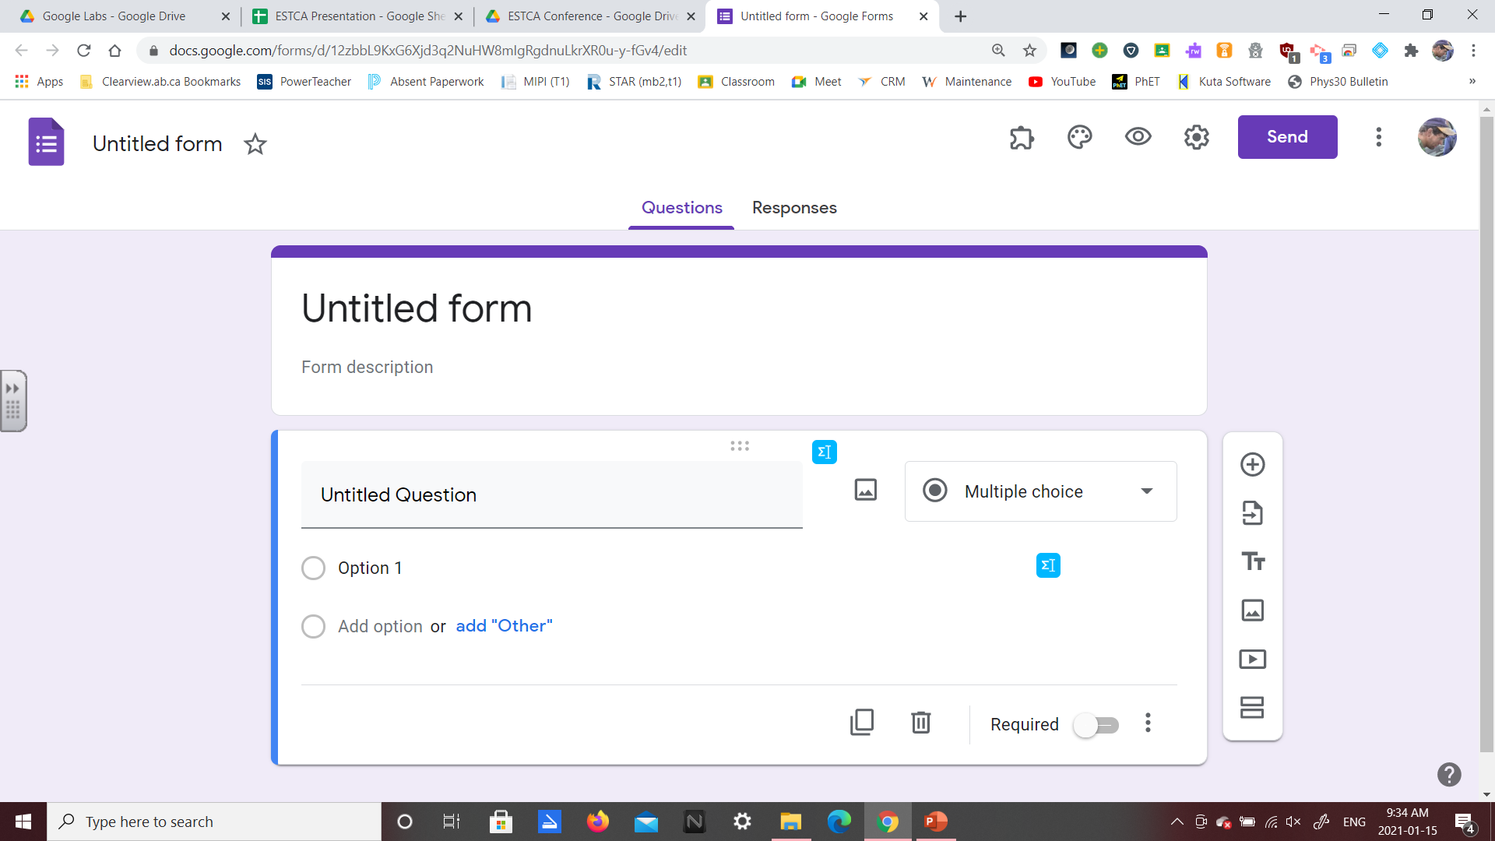
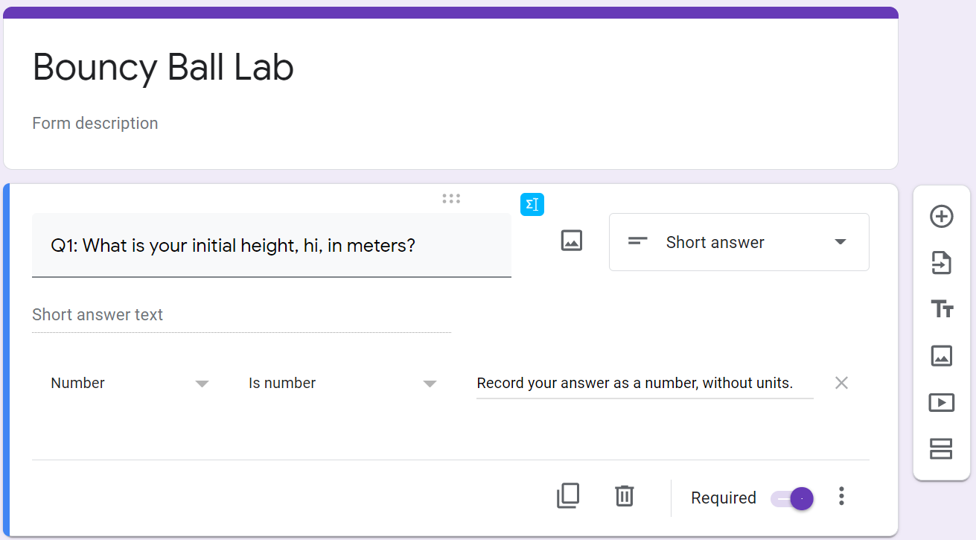
Plan:
Build Google Form for students to submit data.
Export to Google Spreadsheet.
Build Google Spreadsheet formula to mark data.
Questions are recorded as Short answer.
Response validation is turned on using the “three dots” in the bottom right.
Question is toggled to “Required”.

Slide 7
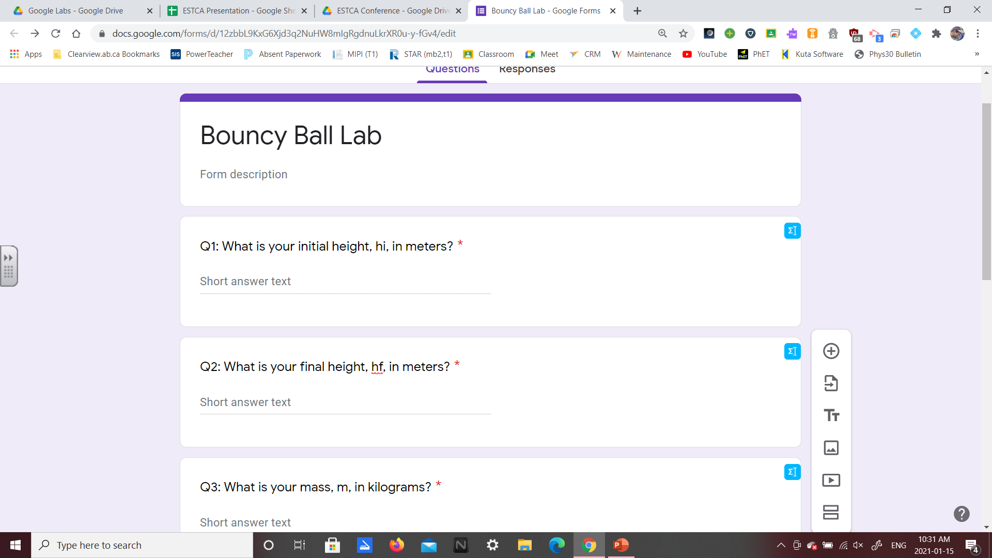
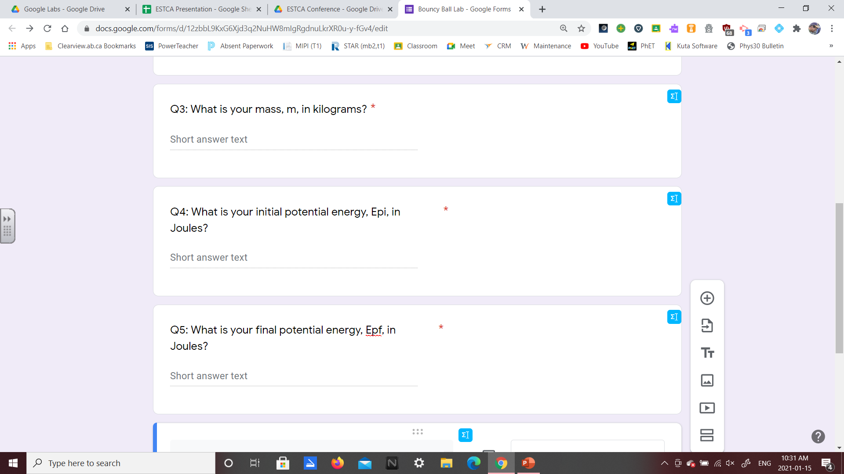
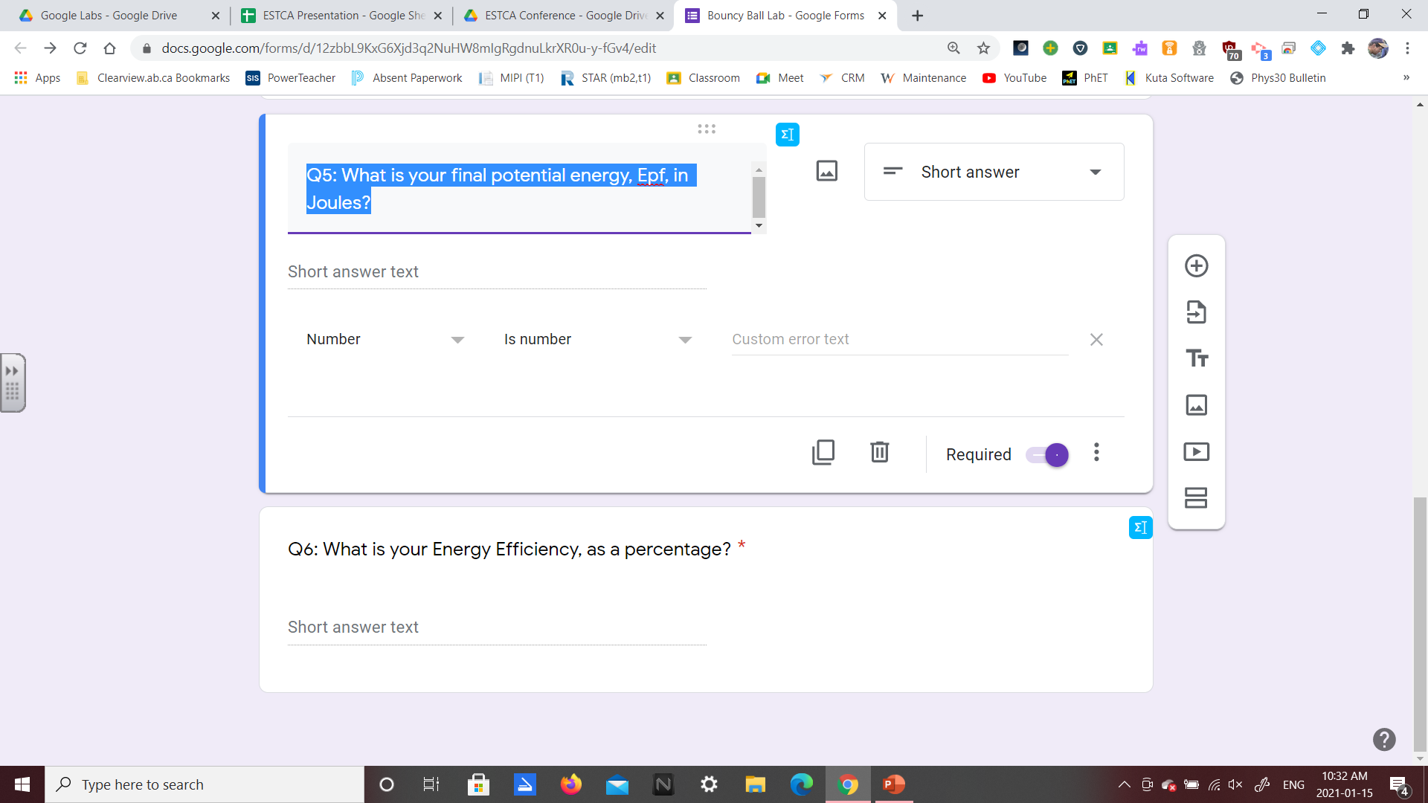
Q1
Q3
Q2
$$h_{i}$$
$$m$$
$$h_{f}$$
Initial Measured Values
Q4
Q5
$${Ep}_{i}=mgh_{i}$$
$${Ep}_{f}=mgh_{f}$$
1 mark
Intermediate Calculations
Q6
$$Eff\left(\%\right)=\frac{Useful E_{out}}{Total E_{in}}x100\%$$
1 mark
Final Answer
1 mark

Slide 8
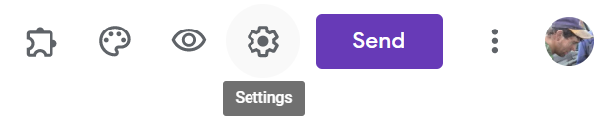
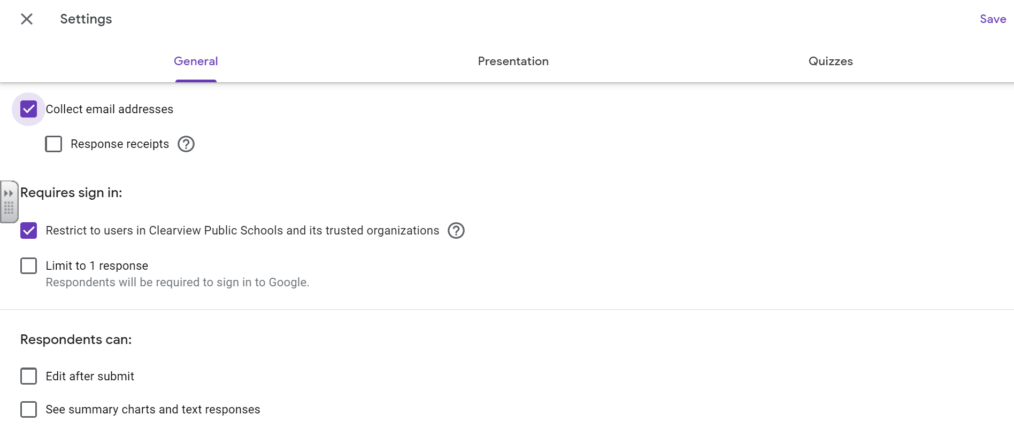
Make adjustments to the “Settings” menu.
Collect email addresses
Limit submissions
Allow editing of submissions
Make sure to turn on “Collect email addresses”
I personally allow multiple submissions…
…but students cannot edit their work after submitting.

Slide 9

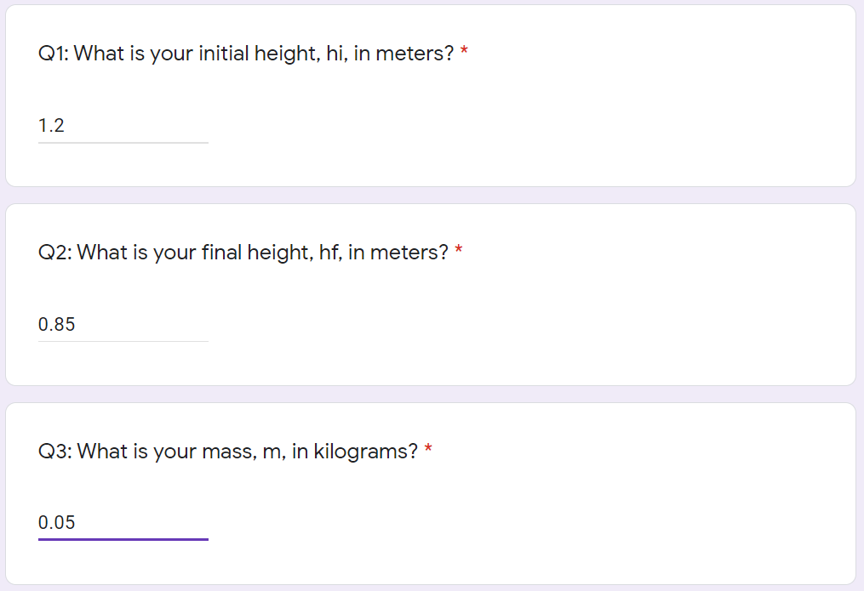
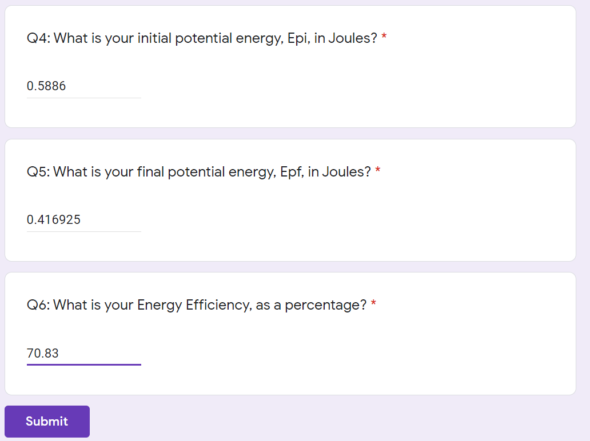
Enter sample data and calculations:
hi = 1.2m hf = 0.85m m = 0.05kg
Epi = 0.5886 J Epf = 0.416925 J Eff(%) = 70.83 %

Slide 10
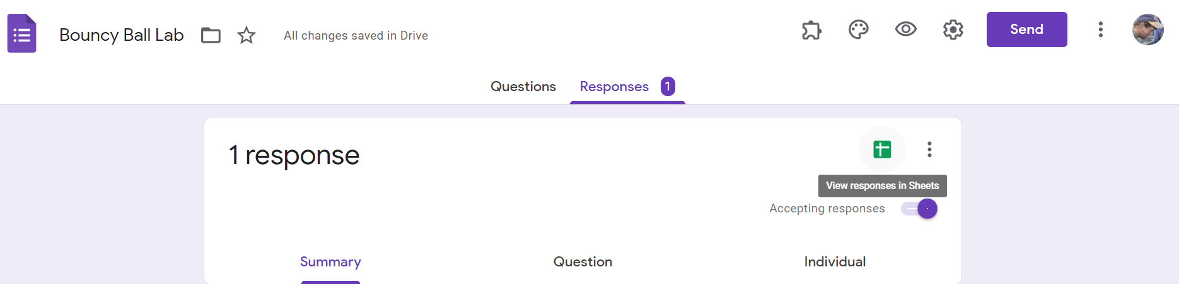
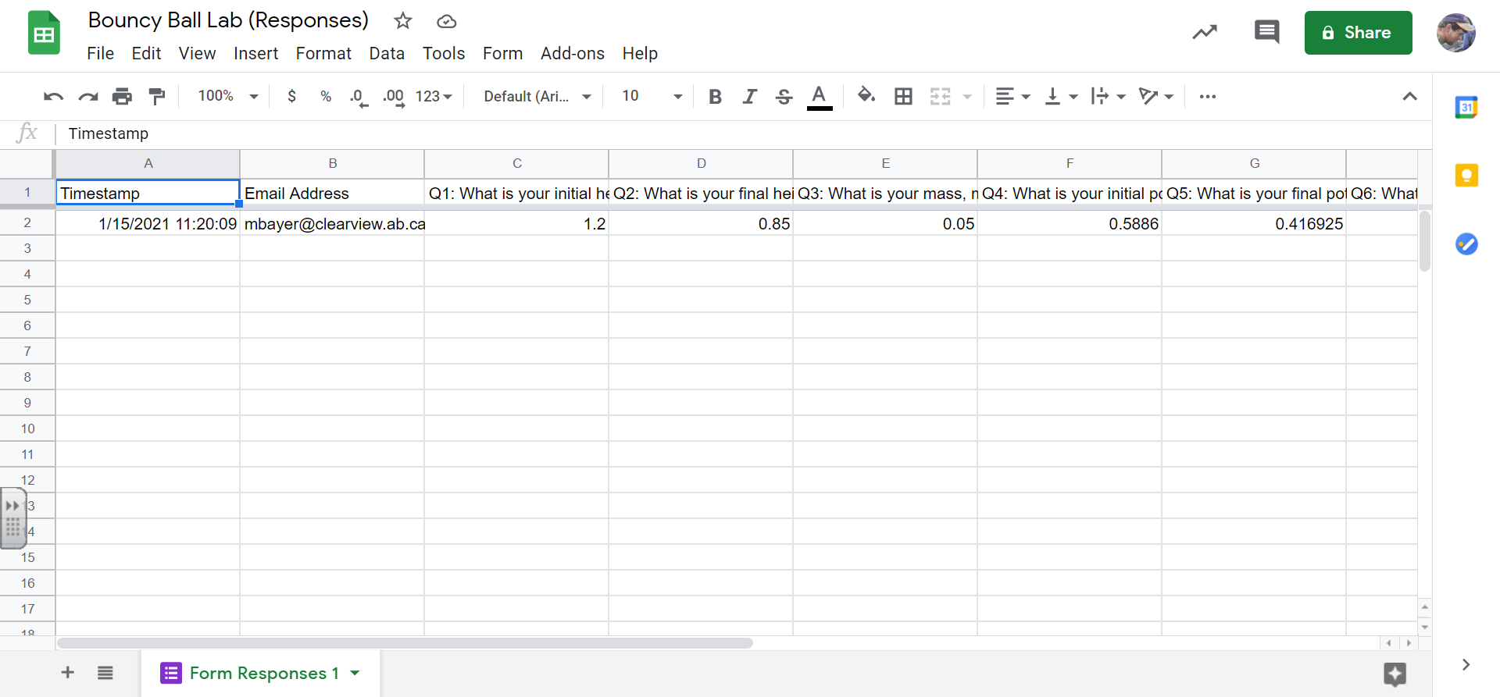
View responses in Sheets
Add Sheet

Slide 11
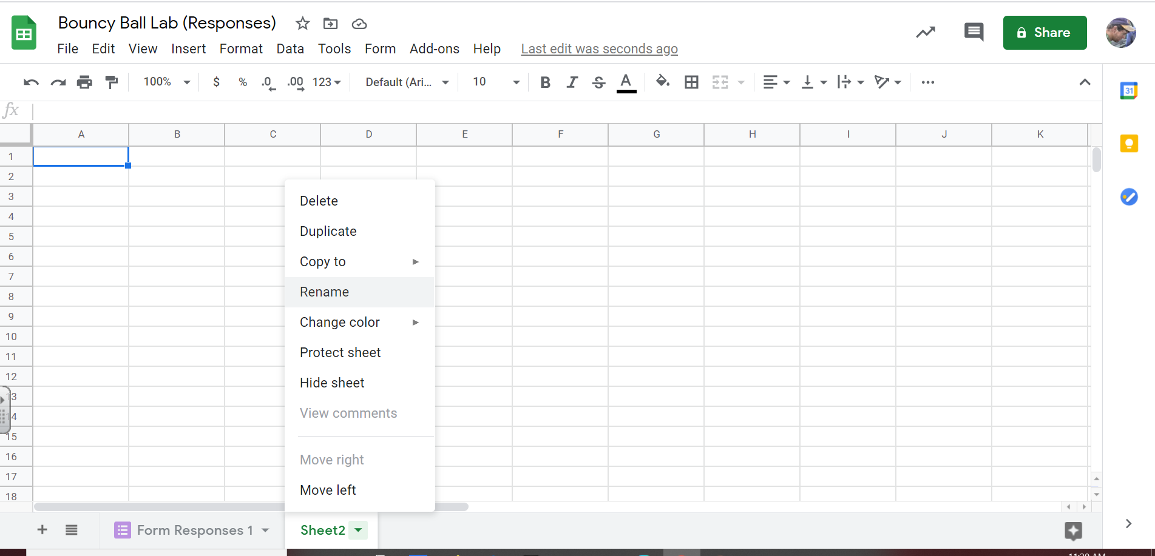
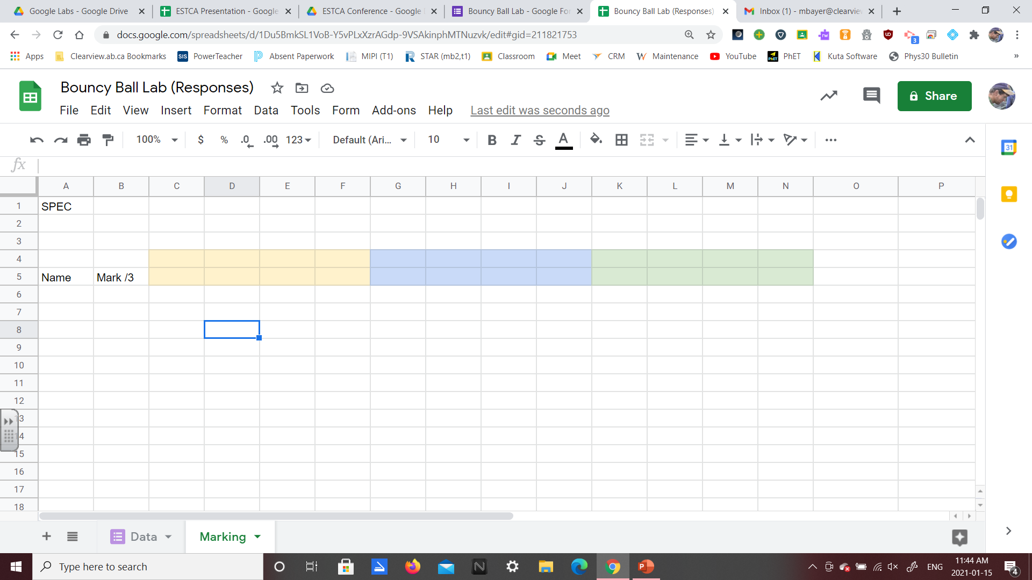
As a personal preference, I’ll rename the sheets as “Data” and “Marking”

Slide 12
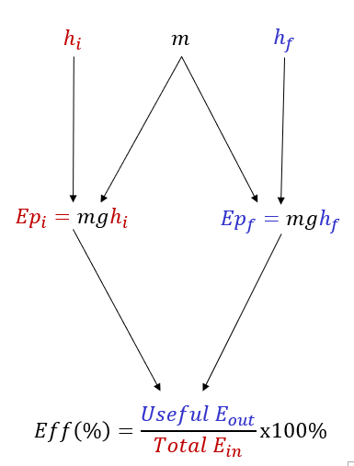

I’ll set up the “SPEC” in Cell A1, and leave some space before labelling a column for “Name” and “Mark /3”, since this activity has 3 calculations, for a total of 3 marks.
For the sake of this presentation, some boxes are colored, but this is not required.
Each colored block represents a single calculation, with the same 4 elements used to determine if the student did the work correctly, and what mark they receive for this part of their overall work.

Slide 13
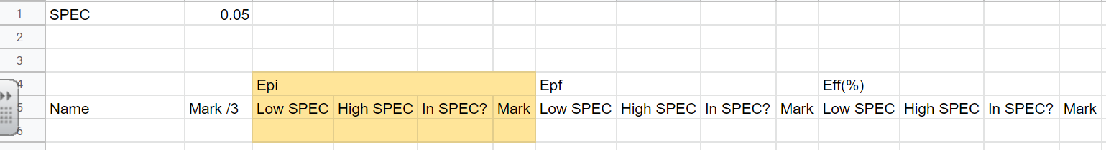
The SPEC is listed as 5%. This can be changed “on the fly” to loosen or tighten the acceptable range.
Low SPEC =(Calculation)*(1-SPEC)
=(mgh_{i})*(0.95)
Set the lower acceptable limit, which is 95% of the true value.
High SPEC =(Calculation)*(1+SPEC)
=(mgh_{i})*(1.05)
Set the upper acceptable limit, which is 105% of the true value.
In SPEC? =AND(Value >Low SPEC, Value < High SPEC)
Make sure students’ answer is greater than lower limit AND less than upper limit. Equation returns “TRUE” or “FALSE”
Mark =IF(In SPEC? = TRUE,1,0)
IF “In Spec?” equals “TRUE”, then return a value of 1.
Otherwise return a value of 0.

Slide 14
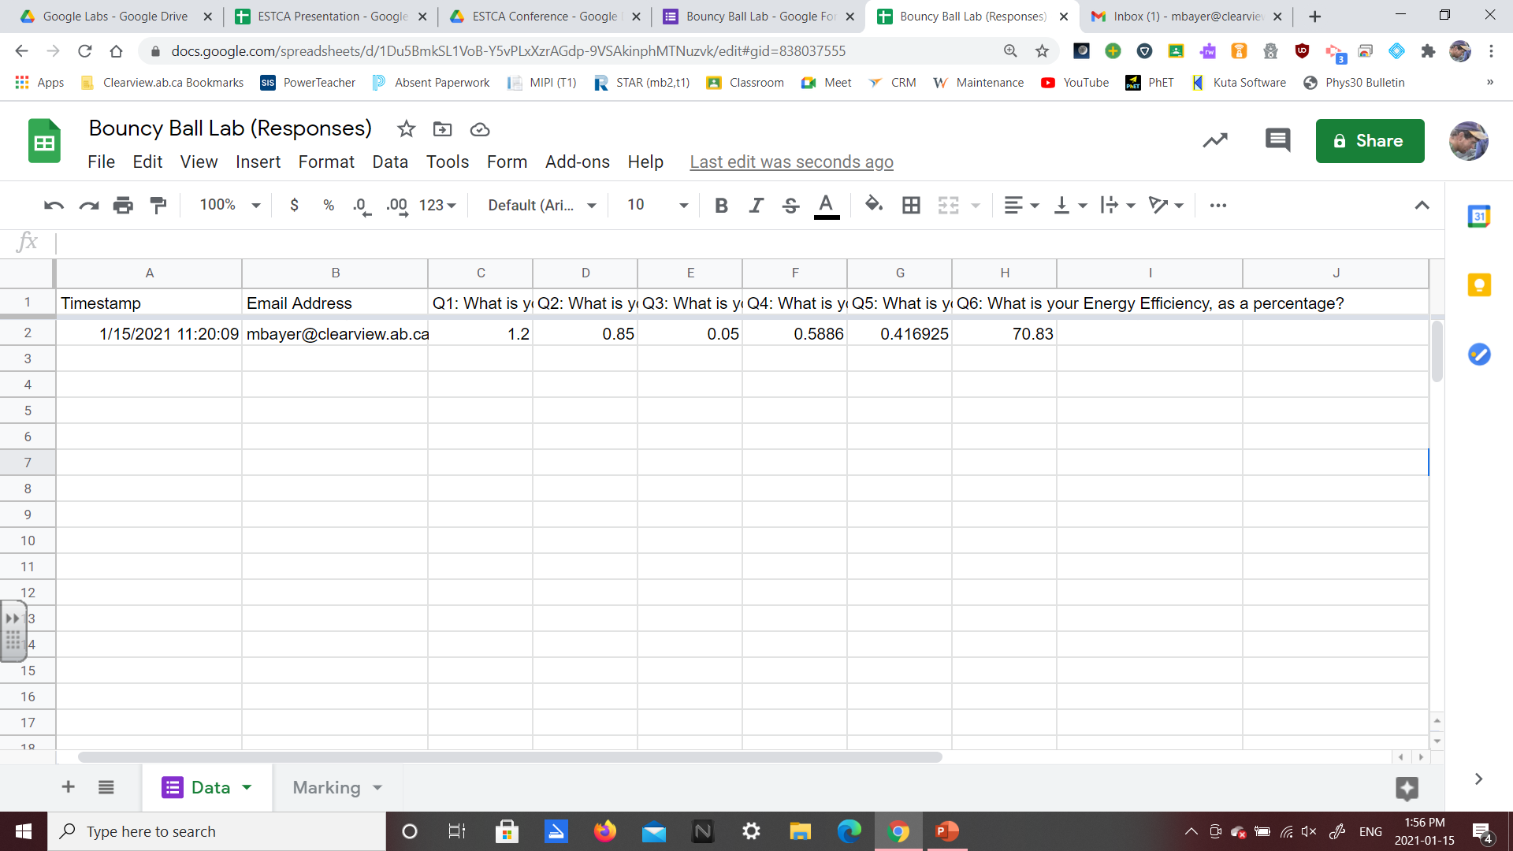
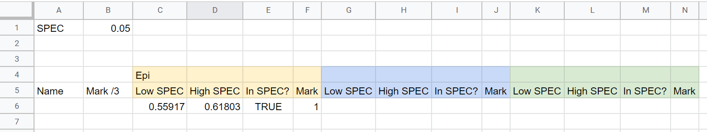

h_{i}
h_{f}
m
Ep_{i}
Ep_{f}
Eff(%)
Data sheet
h_{i}
m
Ep_{i}
SPEC
SPEC
Epf
Eff(%)
Marking sheet
In SPEC?
Low SPEC =(mgh_{i})*(1-SPEC)
=(Data!E2*9.81*Data!C2)*(1-$B$1)
In SPEC? =AND(Value >Low SPEC, Value < High SPEC)
=AND(Data!F2>C6,Data!F2<D6)
High SPEC =(mgh_{i})*(1+SPEC)
=(Data!E2*9.81*Data!C2)*(1+$B$1)
Mark =IF(In SPEC? = TRUE,1,0)
=IF(E6=TRUE,1,0)

Slide 15
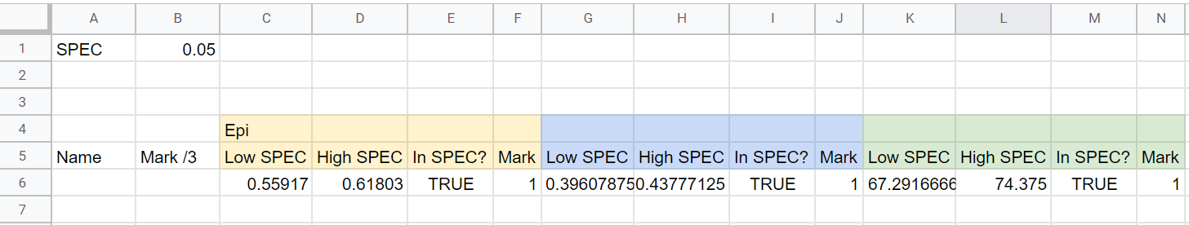

h_{i}
h_{f}
m
Ep_{i}
Ep_{f}
Eff(%)
Data sheet
Ep_{i}
Ep_{f}
Eff(%)
SPEC
Epf
Eff(%)
Marking sheet
In SPEC?
Low SPEC =(Ep_{f}/Ep_{i})*100*(1-SPEC)
=(Data!G2/Data!F2)*100*(1-$B$1)
In SPEC? =AND(Value >Low SPEC, Value < High SPEC)
=AND(Data!H2>K6,Data!H2<L6)
High SPEC =(Ep_{f}/Ep_{i})*100*(1+SPEC)
=(Data!G2/Data!F2)*100*(1+$B$1)
Mark =IF(In SPEC? = TRUE,1,0)
=IF(M6=TRUE,1,0)

Slide 16
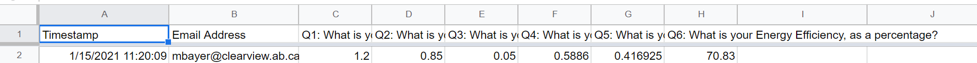
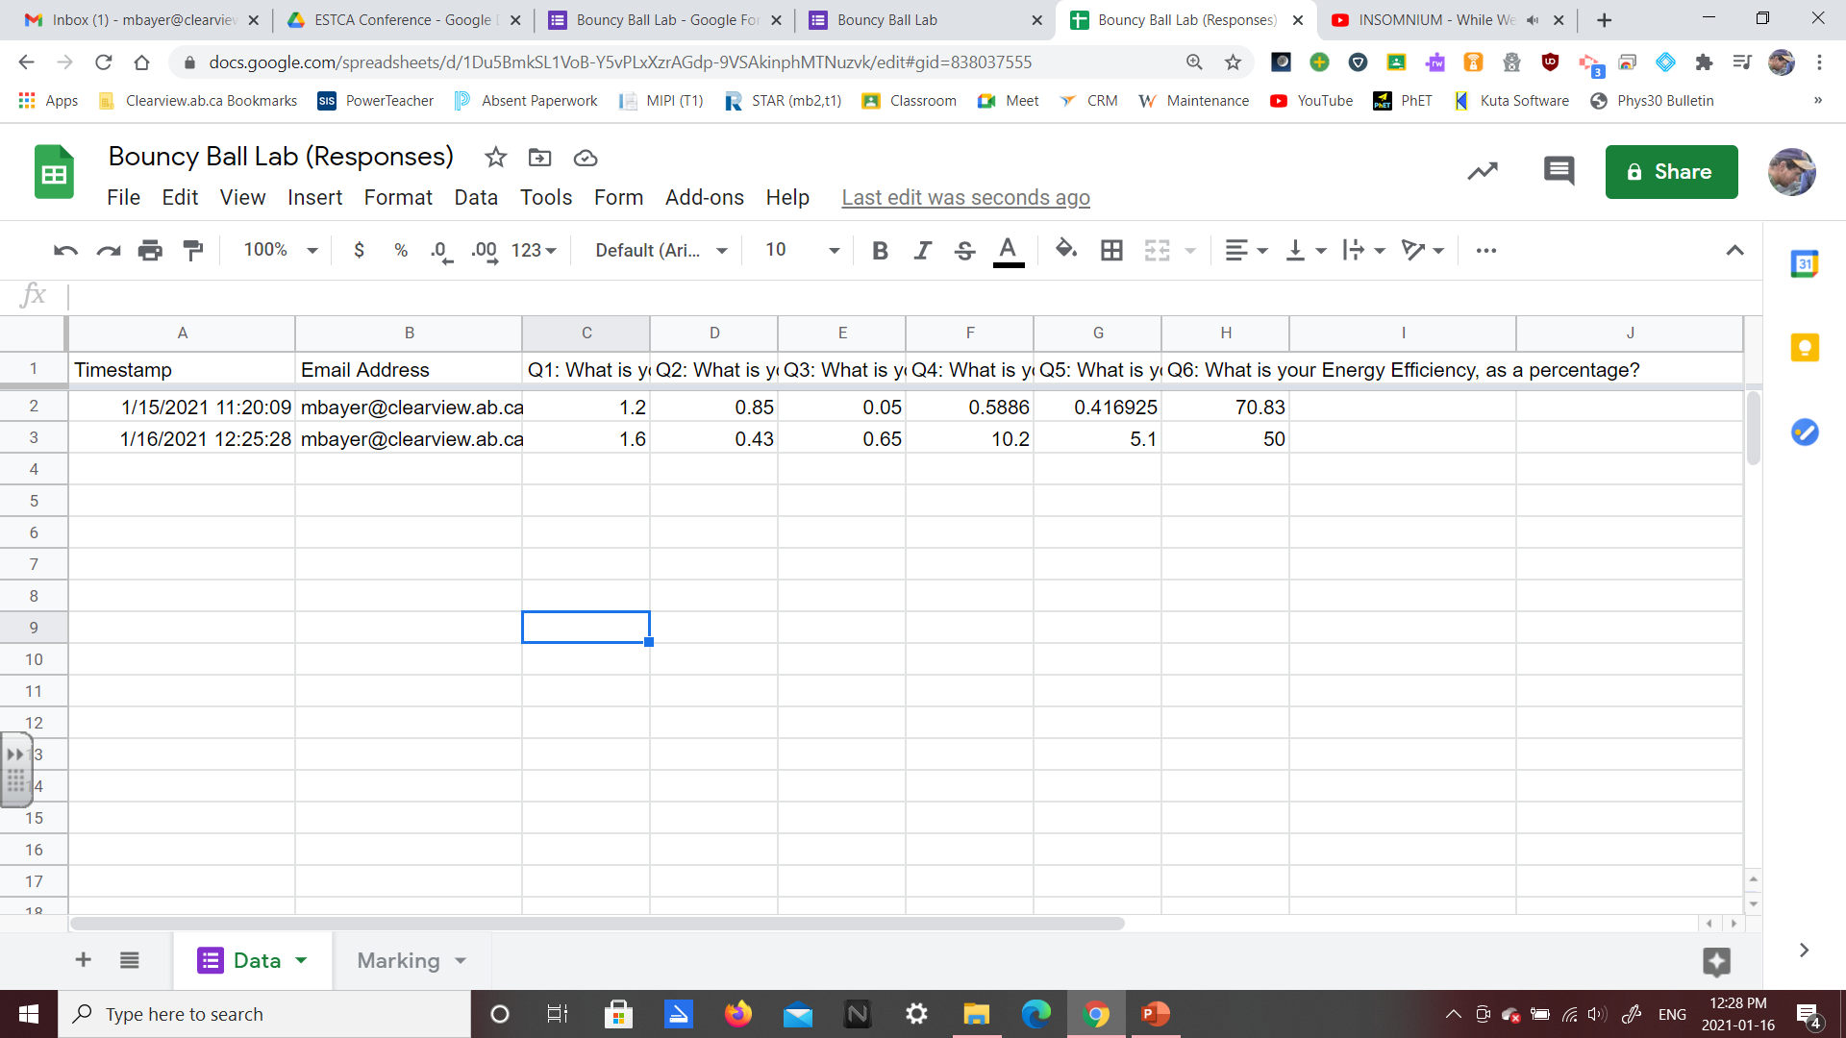
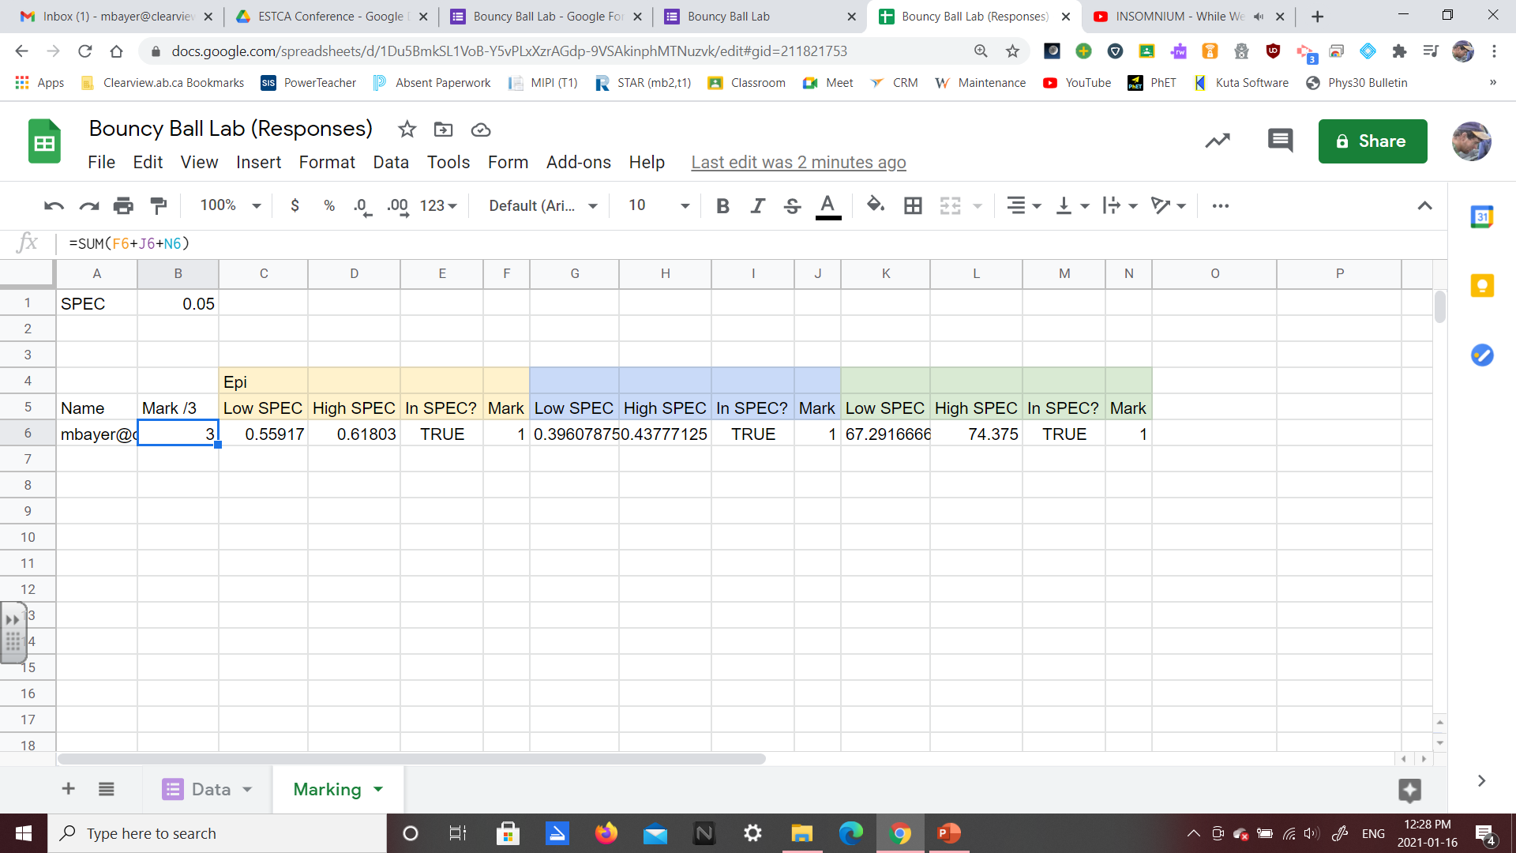
Epf
Eff(%)
Name =Data!B2
Mark /3 =SUM(F6+J6+N6)

Slide 17
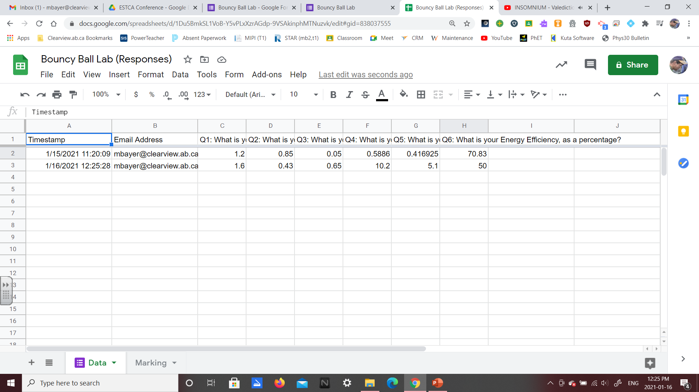
Now I’m adding a second student’s data.
If the student had a ball of mass 650g, dropped the ball from a height of 1.6m, and found the ball returned to a height of 0.43m, then their work should look like the following:
m = 0.65kg Ep_{i} = 10.2024 J
g = 9.81 m/s² Ep_{f} = 2.741895 J
h_{i} = 1.6m Eff(%) = 26.875 %
h_{f} = 0.43m
But instead the student miscalculated Ep_{f} , then correctly carried through their mistake:
Ep_{i} = 10.2 J
Ep_{f} = 5.1 J (this is a mistake)
Eff (%) = 50.0% (this is correct given the prior mistake)

Slide 18
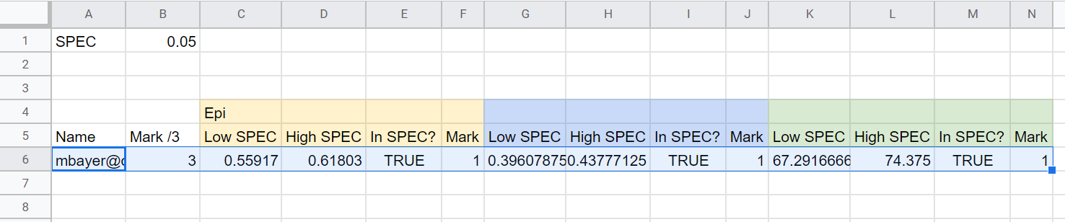
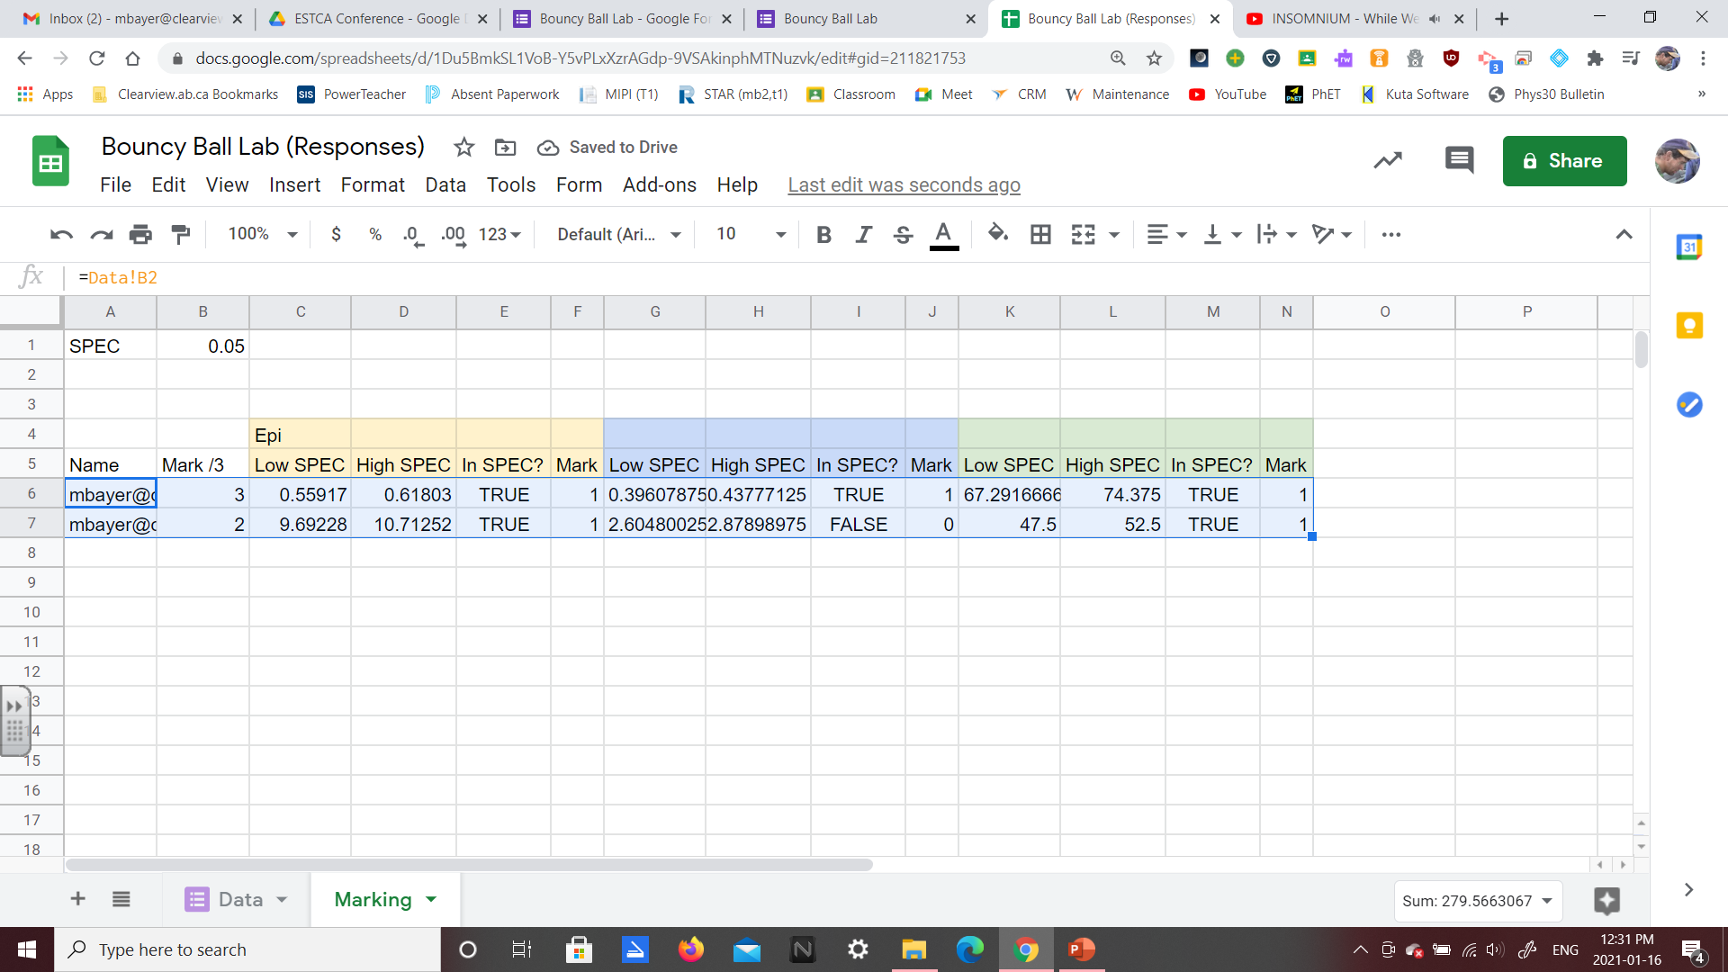
In Row 3, we can see the student’s submitted work with the Epf mistake.
Epf
Eff(%)
To “auto-mark”, first highlight a completed row. Grab the tiny box in the bottom right corner and drag down.
Epf
Epf
Eff(%)
We can now see in Row 7 that the work earned 2 of 3 marks. They correctly calculated Epi, incorrectly calculated Epf, but then carried through their mistake correctly to calculate Eff(%).
Epf

Slide 19

Examples:
Initial Speed of a Throw
Momentum Cars

Slide 20
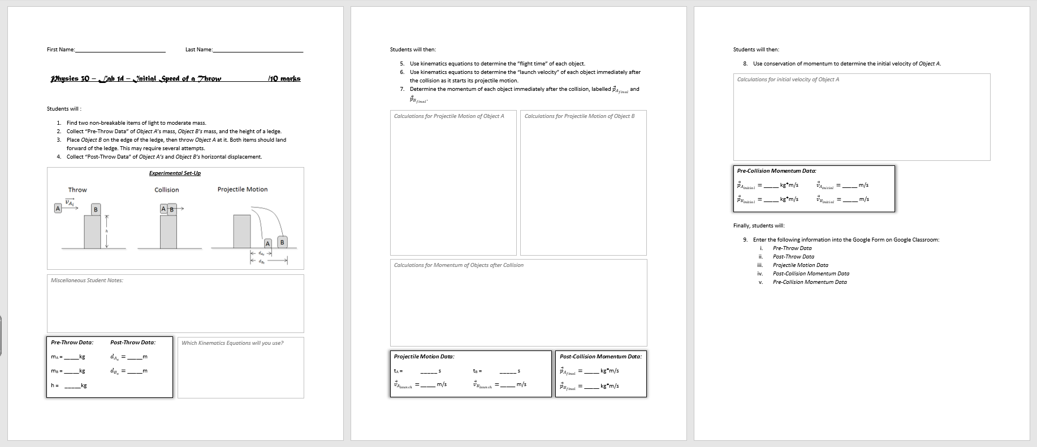
Given the amount of work required to build this Google Form, why would we choose to do this over just marking by hand?
The same Google Form can be used year-after-year.
For more complicated labs, it is quicker to build the Google Form than mark a class set by hand.
Example: Initial Speed of a Throw Lab
This lab requires 10 calculations (7 if students have a strong understanding).

Slide 21
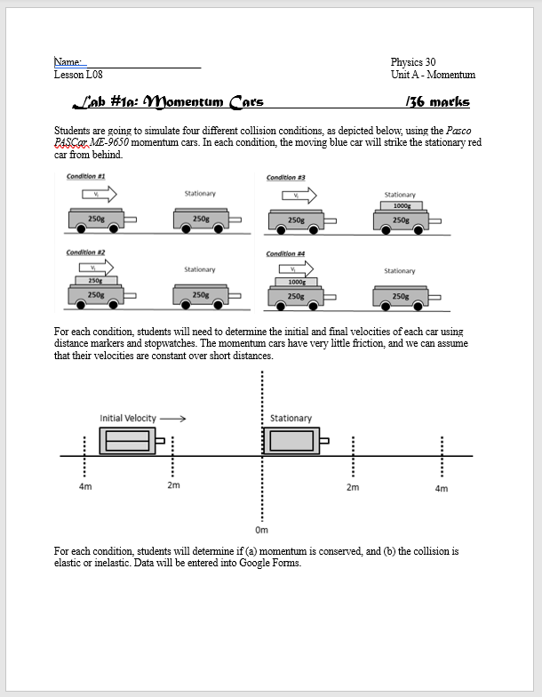
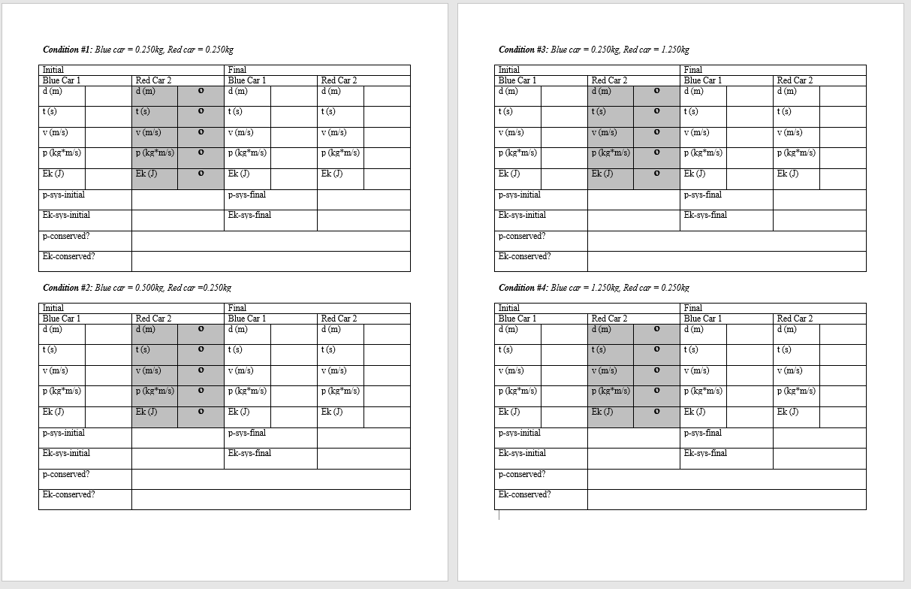
Example: Initial Speed of a Throw Lab
For each of the four conditions, there are 15 distinct calculations required.

Slide 22

Step-by-Step Videos:
Building a Google Form
Building a Google Spreadsheet

