Slide 1
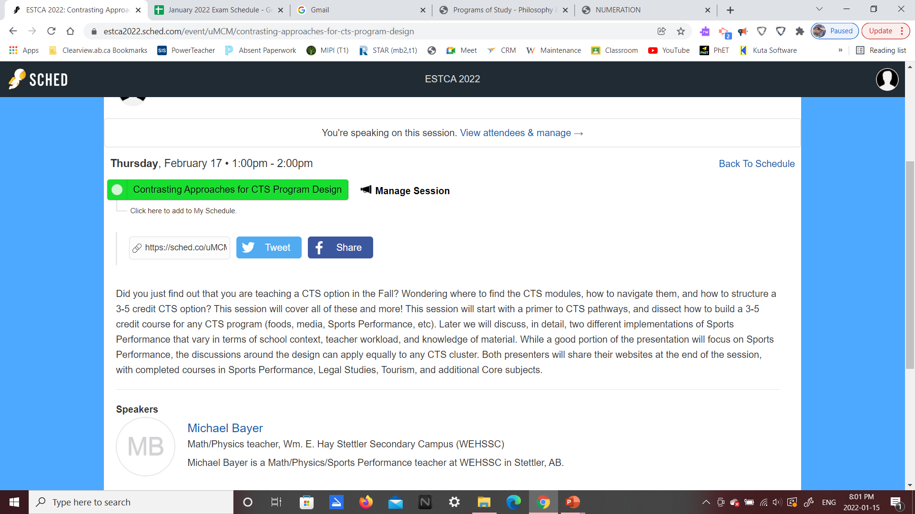
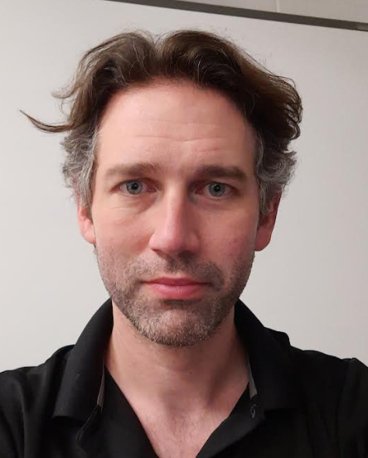
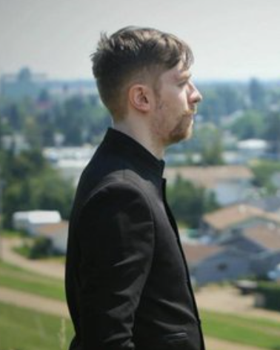
Michael Bayer
Kyle McIntosh

Slide 2
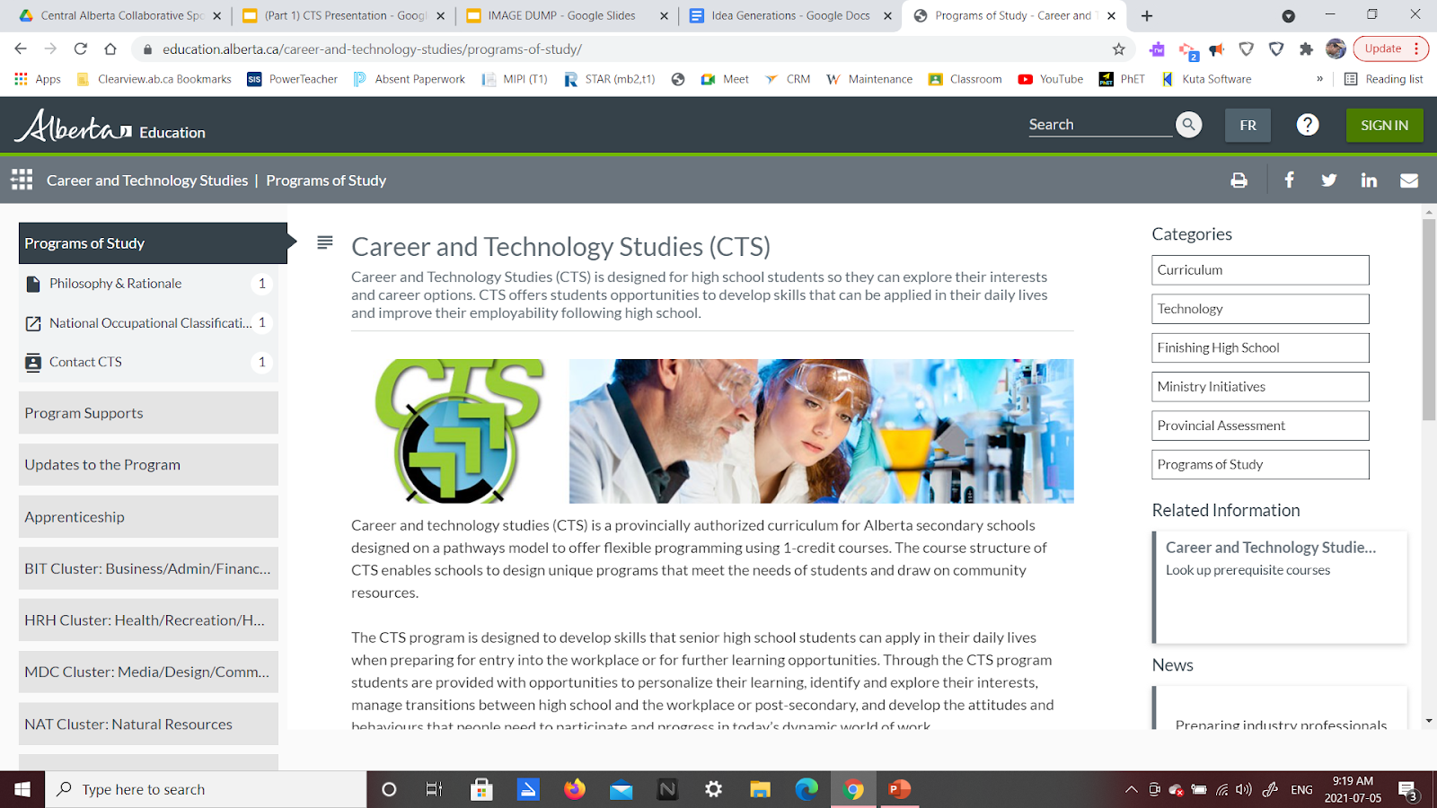
CTS Website Organization
Prereqs to Pathways
Sample CTS Courses
Bayer’s SPPRF
McIntosh’s SPPRF
Contextual Differences
Closing and Website
https://education.alberta.ca/career-and-technology-studies/programs-of-study/

Slide 3
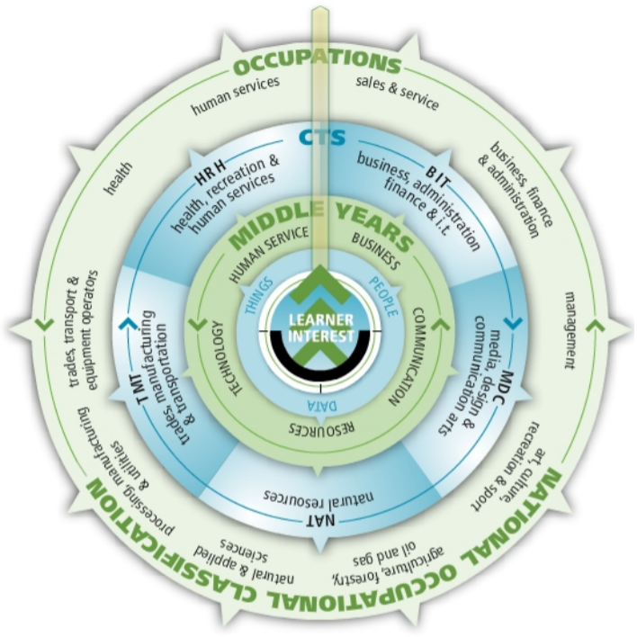
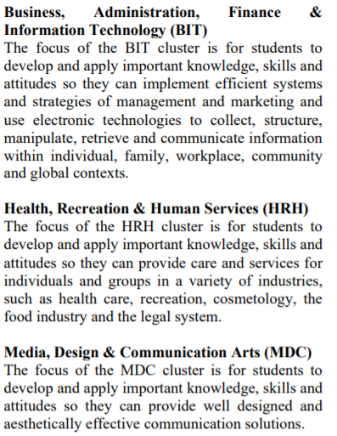
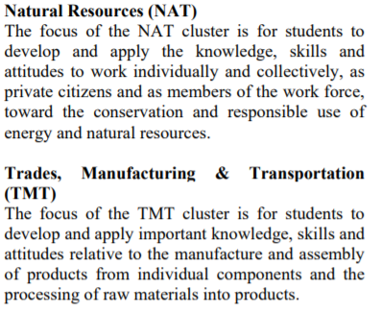
CTS Website Organization
Prereqs to Pathways
Sample CTS Courses
Bayer’s SPPRF
McIntosh’s SPPRF
Contextual Differences
Closing and Website

Slide 4
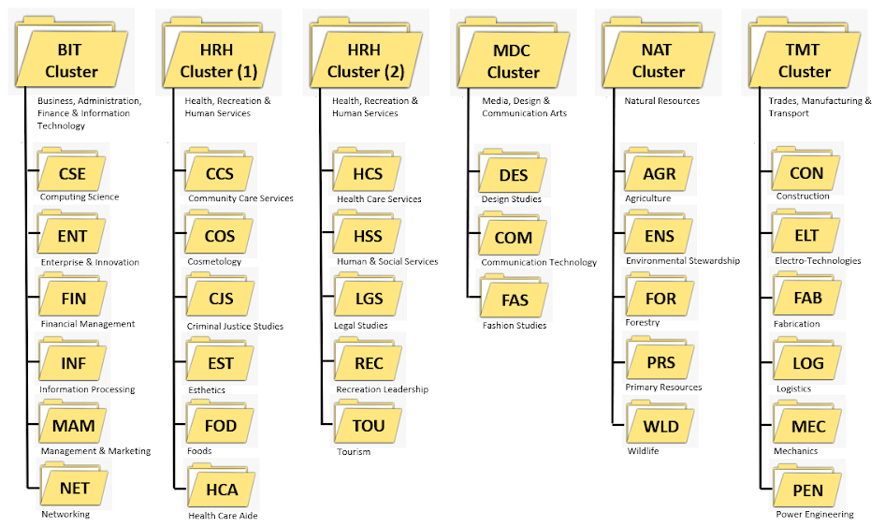
CTS Website Organization
Prereqs to Pathways
Sample CTS Courses
Bayer’s SPPRF
McIntosh’s SPPRF
Contextual Differences
Closing and Website

Slide 5
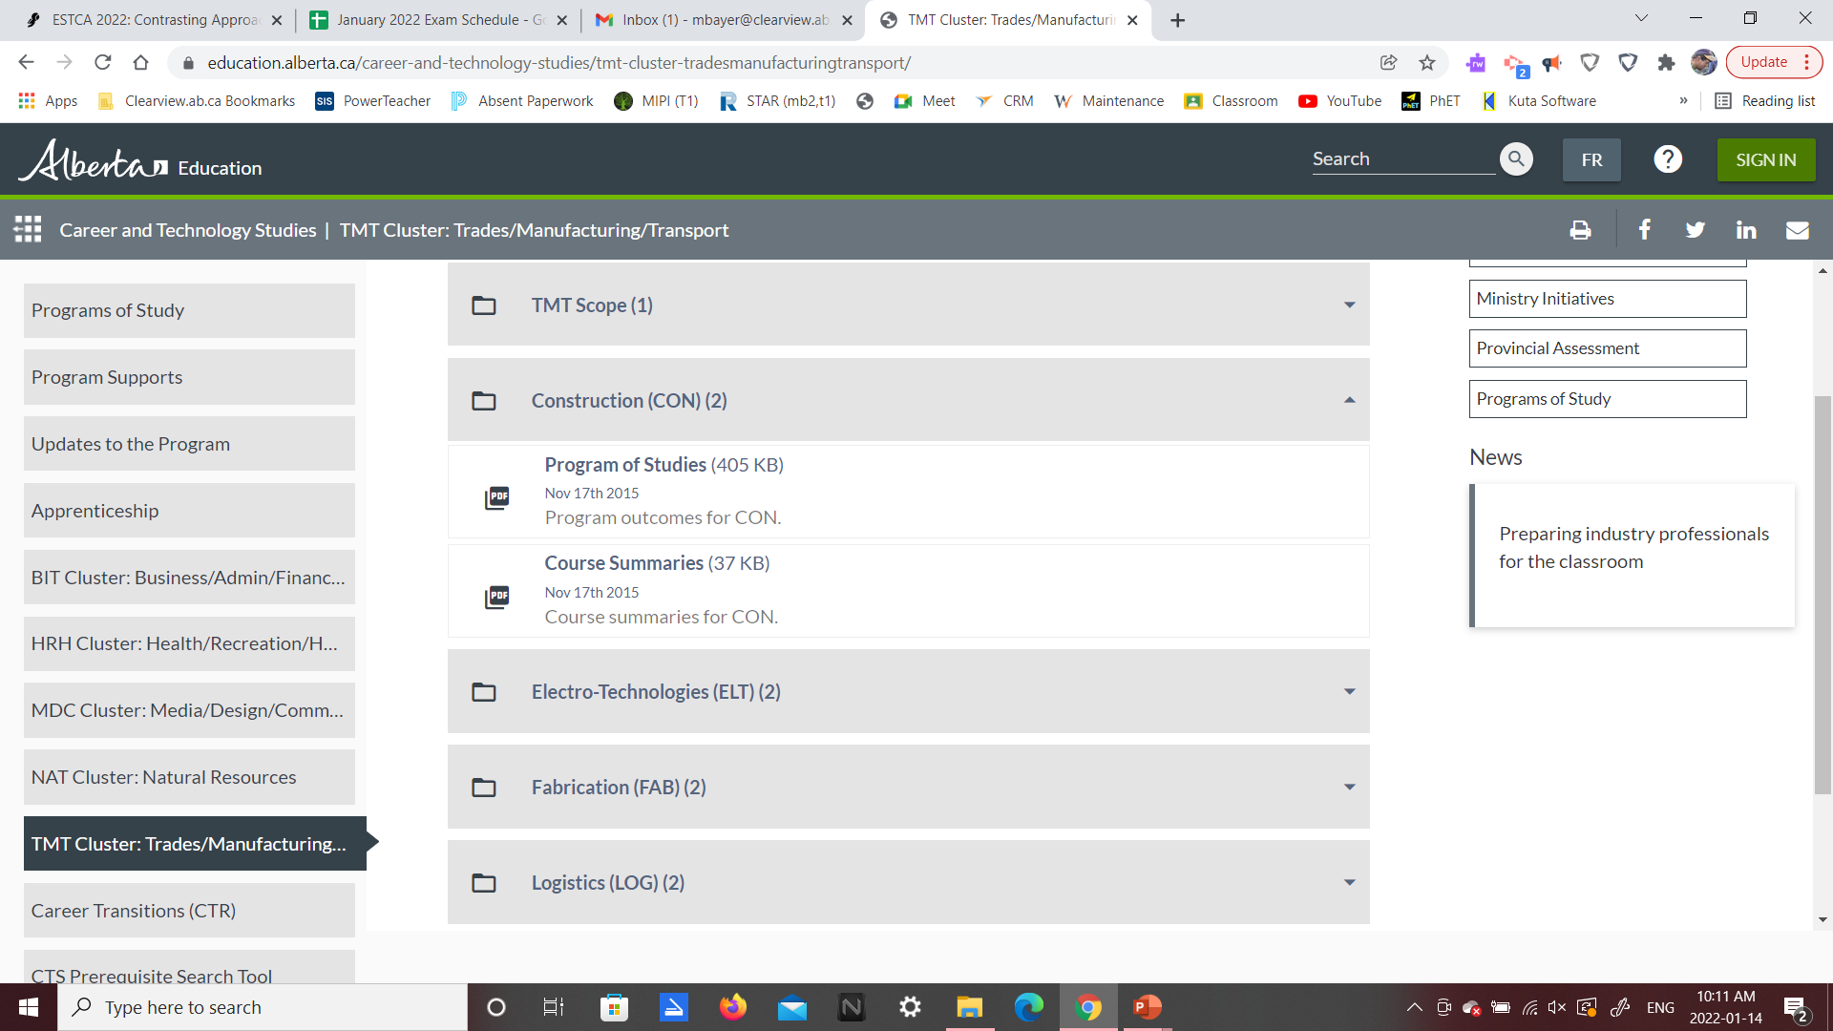
CTS Website Organization
Prereqs to Pathways
Sample CTS Courses
Bayer’s SPPRF
McIntosh’s SPPRF
Contextual Differences
Closing and Website
Construction

Slide 6
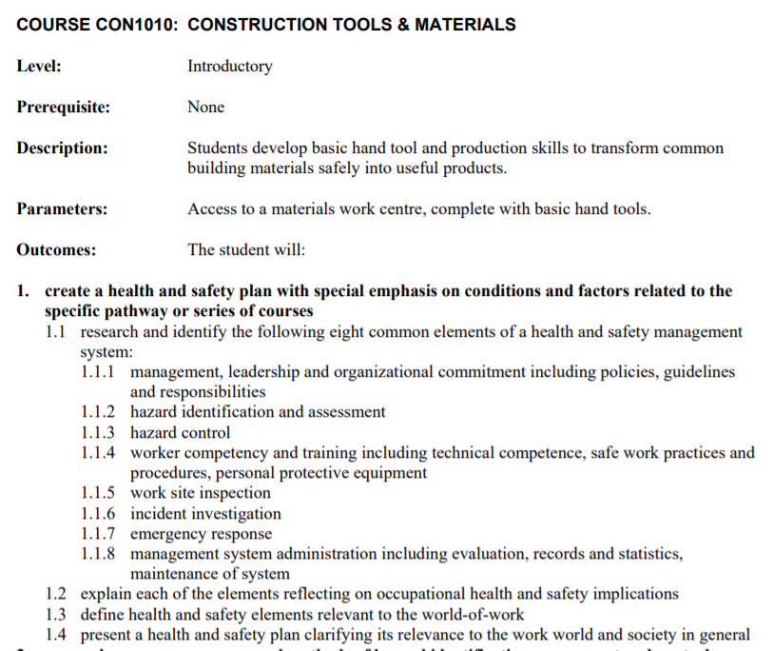
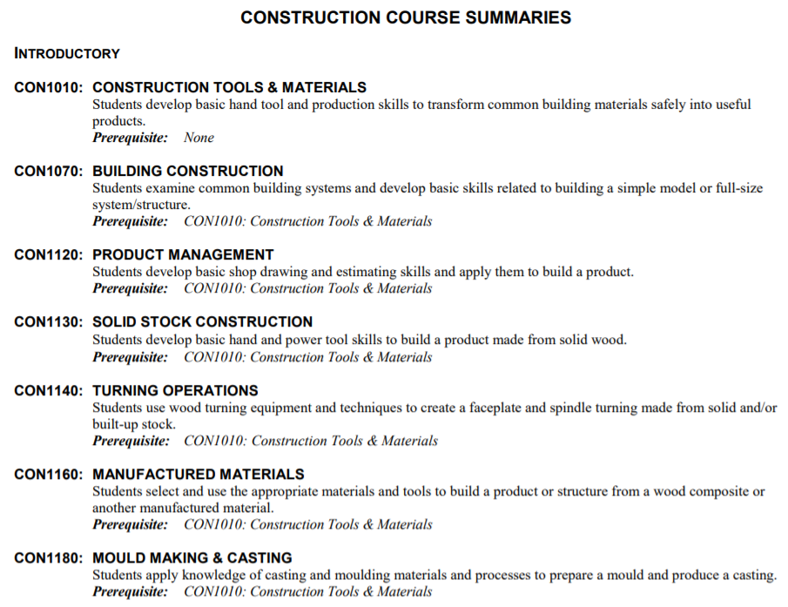
CTS Website Organization
Prereqs to Pathways
Sample CTS Courses
Bayer’s SPPRF
McIntosh’s SPPRF
Contextual Differences
Closing and Website
Construction

Slide 7
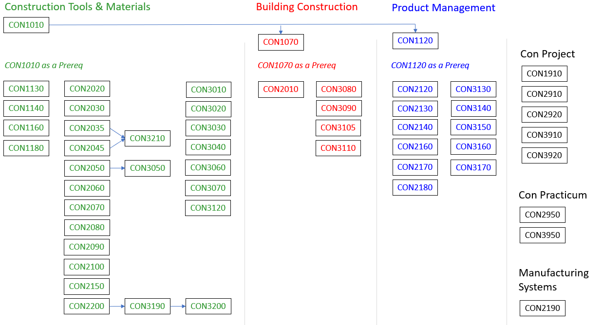
CTS Website Organization
Prereqs to Pathways
Sample CTS Courses
Bayer’s SPPRF
McIntosh’s SPPRF
Contextual Differences
Closing and Website
Construction

Slide 8
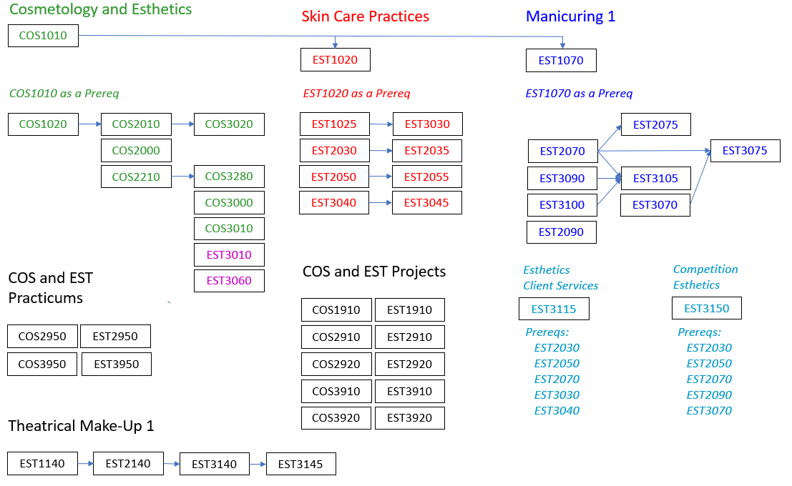
CTS Website Organization
Prereqs to Pathways
Sample CTS Courses
Bayer’s SPPRF
McIntosh’s SPPRF
Contextual Differences
Closing and Website
Cosmetology and Esthetics

Slide 9
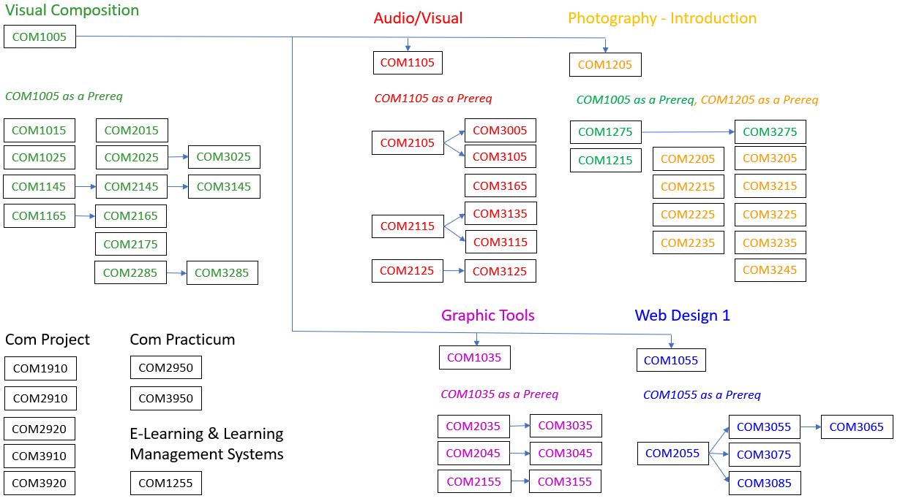
CTS Website Organization
Prereqs to Pathways
Sample CTS Courses
Bayer’s SPPRF
McIntosh’s SPPRF
Contextual Differences
Closing and Website
Communication Technology

Slide 10
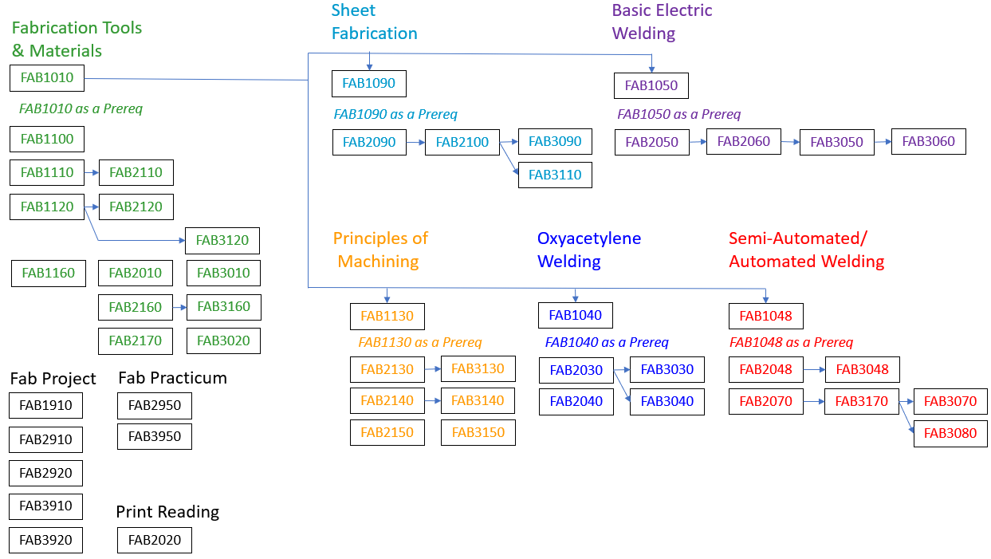
CTS Website Organization
Prereqs to Pathways
Sample CTS Courses
Bayer’s SPPRF
McIntosh’s SPPRF
Contextual Differences
Closing and Website
Fabrication

Slide 11
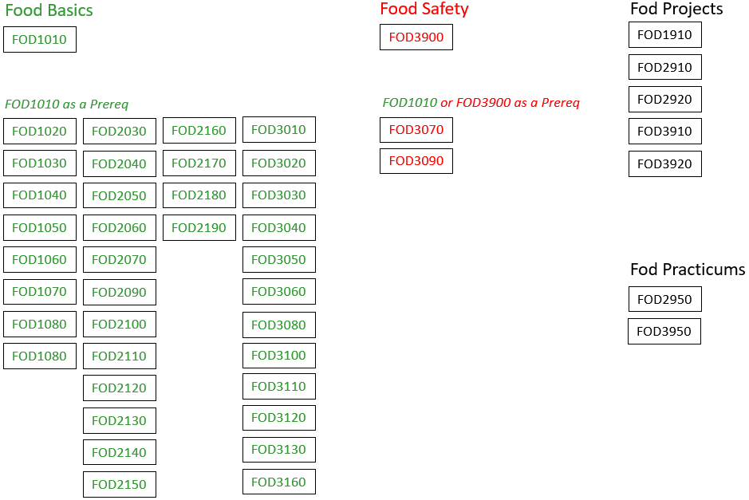
CTS Website Organization
Prereqs to Pathways
Sample CTS Courses
Bayer’s SPPRF
McIntosh’s SPPRF
Contextual Differences
Closing and Website
Foods

Slide 12
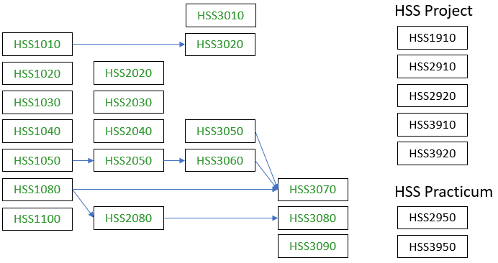
CTS Website Organization
Prereqs to Pathways
Sample CTS Courses
Bayer’s SPPRF
McIntosh’s SPPRF
Contextual Differences
Closing and Website
Health & Social Services

Slide 13
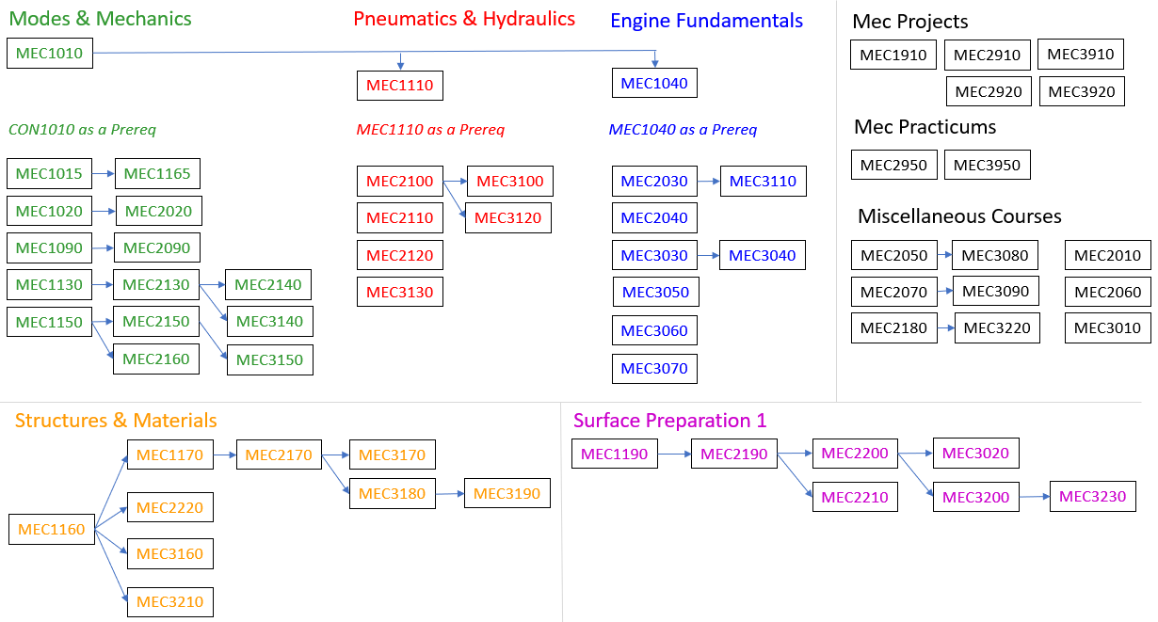
CTS Website Organization
Prereqs to Pathways
Sample CTS Courses
Bayer’s SPPRF
McIntosh’s SPPRF
Contextual Differences
Closing and Website
Mechanics

Slide 14
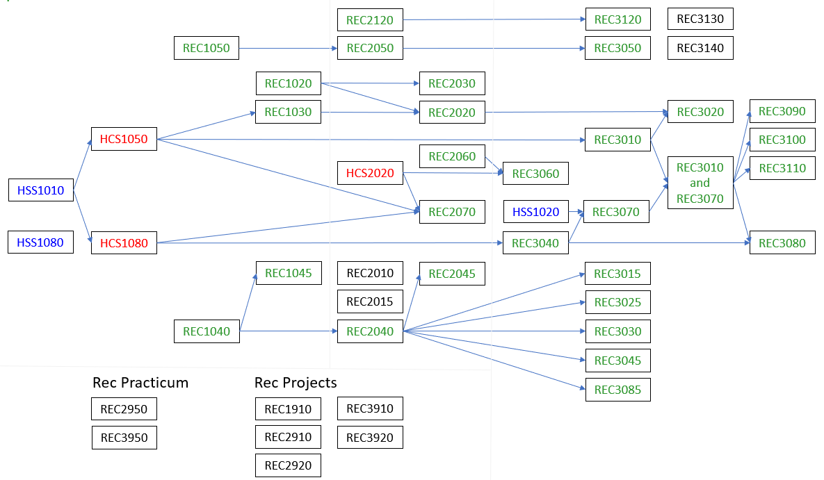
CTS Website Organization
Prereqs to Pathways
Sample CTS Courses
Bayer’s SPPRF
McIntosh’s SPPRF
Contextual Differences
Closing and Website
Recreation (Sports Performance)

Slide 15

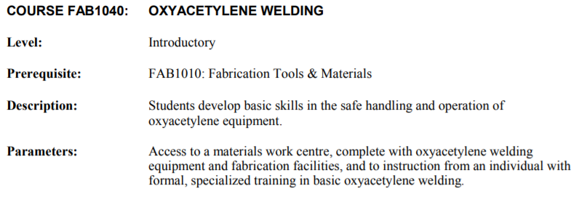
Prereqs to Pathways
Sample CTS Courses
Bayer’s SPPRF
McIntosh’s SPPRF
Contextual Differences
Closing and Website

Slide 16
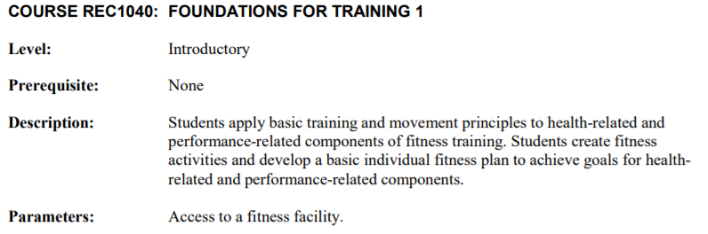
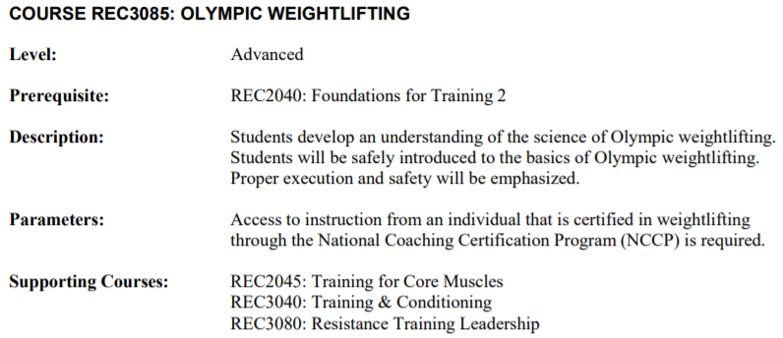
Prereqs to Pathways
Sample CTS Courses
Bayer’s SPPRF
McIntosh’s SPPRF
Contextual Differences
Closing and Website

Slide 17
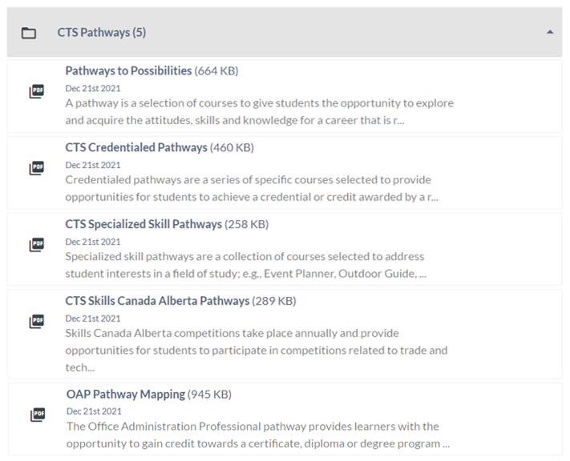
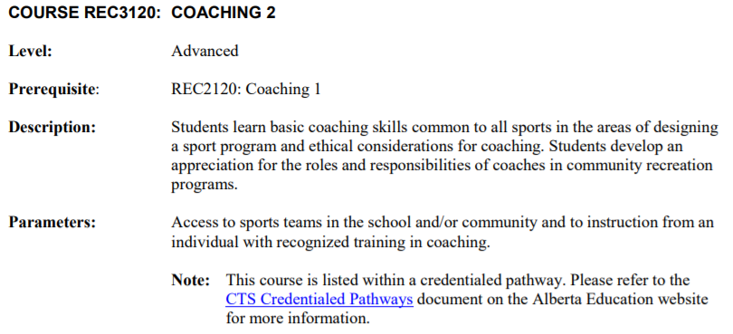
Prereqs to Pathways
Sample CTS Courses
Bayer’s SPPRF
McIntosh’s SPPRF
Contextual Differences
Closing and Website

Slide 18
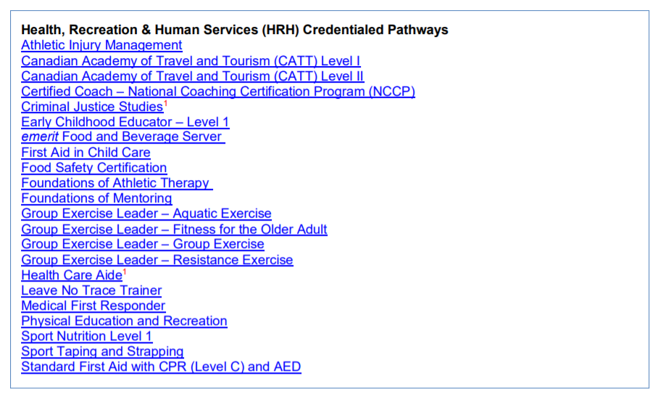
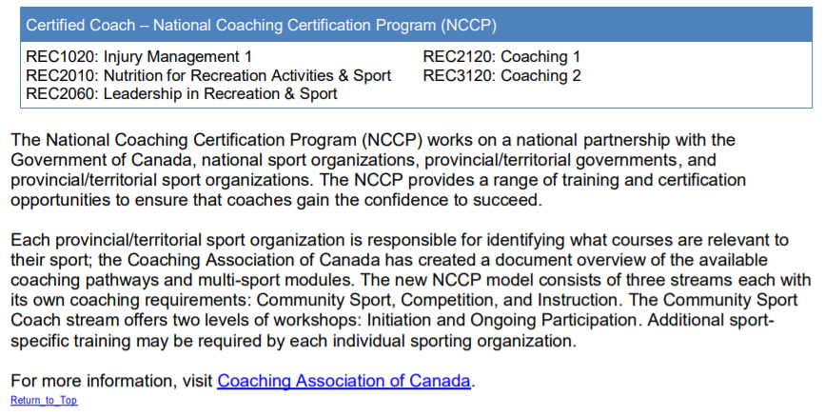
Prereqs to Pathways
Sample CTS Courses
Bayer’s SPPRF
McIntosh’s SPPRF
Contextual Differences
Closing and Website

Slide 19
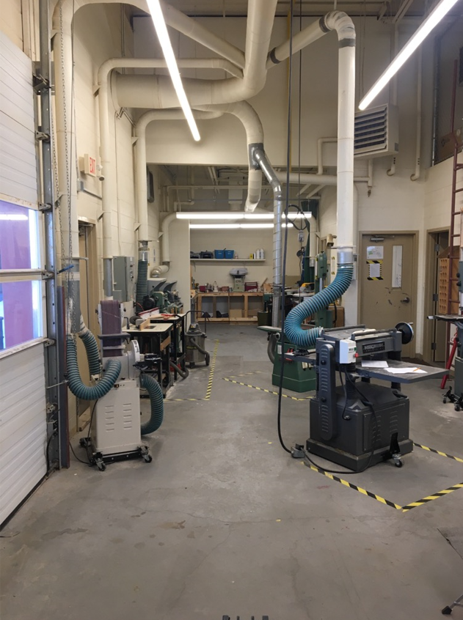
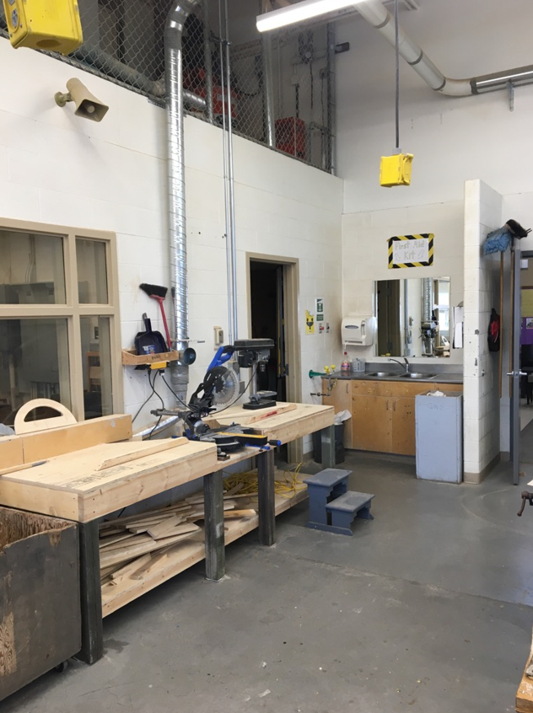
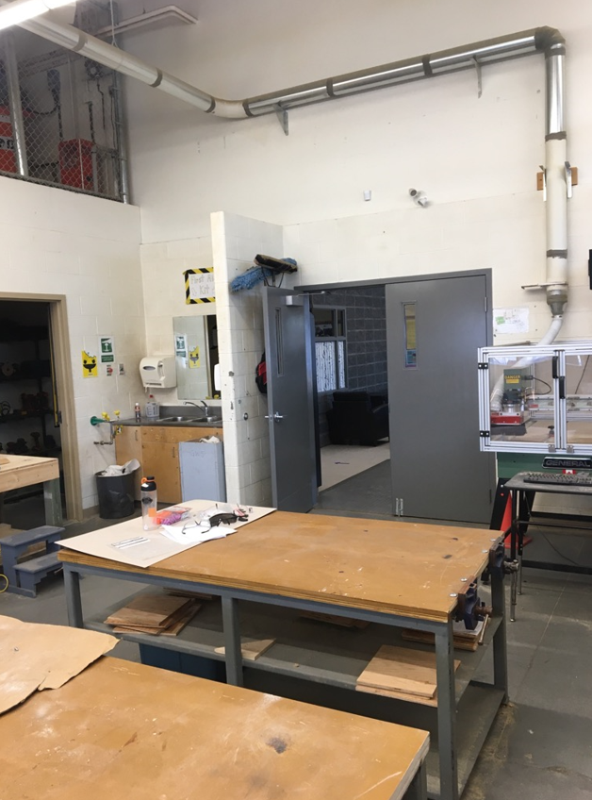
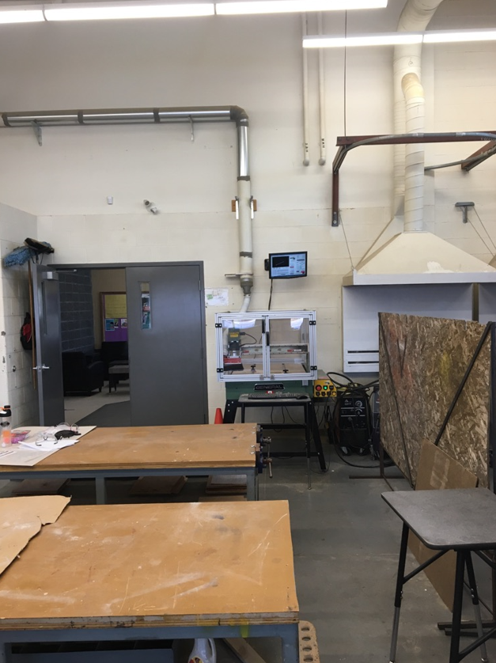
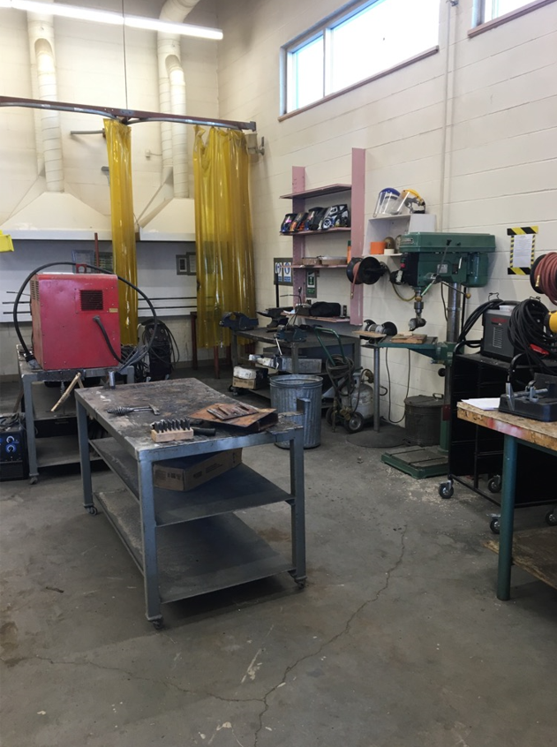
Sample CTS Courses
Bayer’s SPPRF
McIntosh’s SPPRF
Contextual Differences
Closing and Website
Mixed Construction/
Fabrication Shop Class
Woodshop
Woodshop
Woodshop
Woodshop
Welding

Slide 20
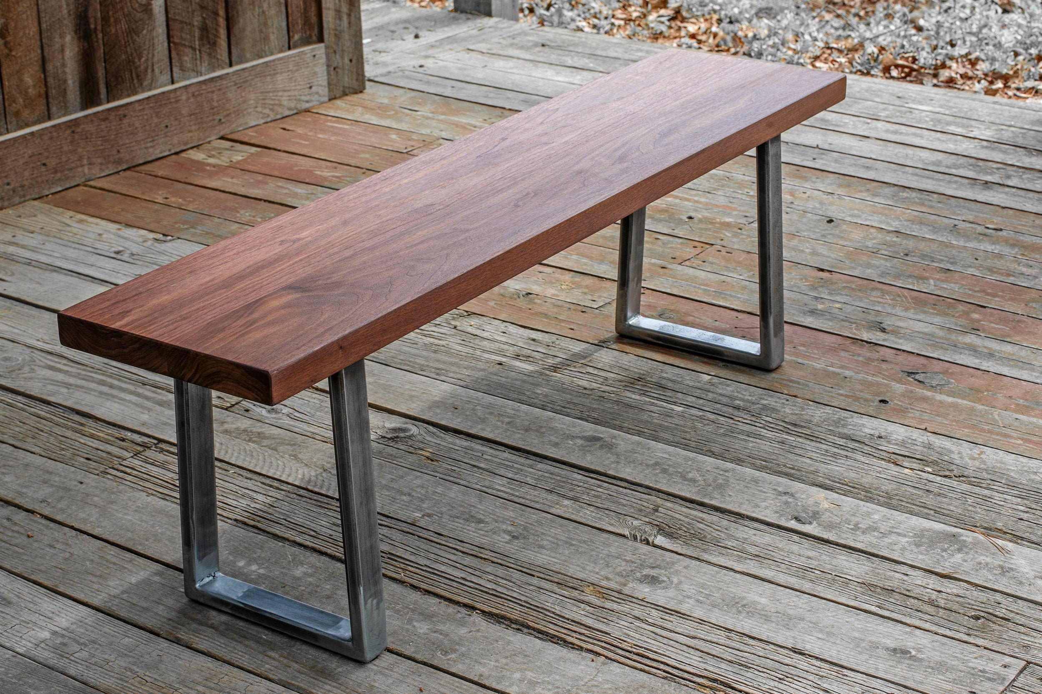

Sample CTS Courses
Bayer’s SPPRF
McIntosh’s SPPRF
Contextual Differences
Closing and Website
Mixed Construction/
Fabrication Shop Class
Project: Wooden Table with Metal Legs
Prereqs: None
CON1010: Construction Tools & Materials
CON1120: Project Management
CON1910: CON Project A
FAB1010: Fabrication Tools & Materials
FAB1050: Basic Electric Welding
Project: Table with Epoxy Resin
Prereqs: CON1010, CON1120
CON2120: Multiple Materials
CON2150: Finishing & Refinishing
CON3130: Furniture – Leg & Rail
CON3140: Furniture – Surface Enhancement
CON2910: CON Project B

Slide 21
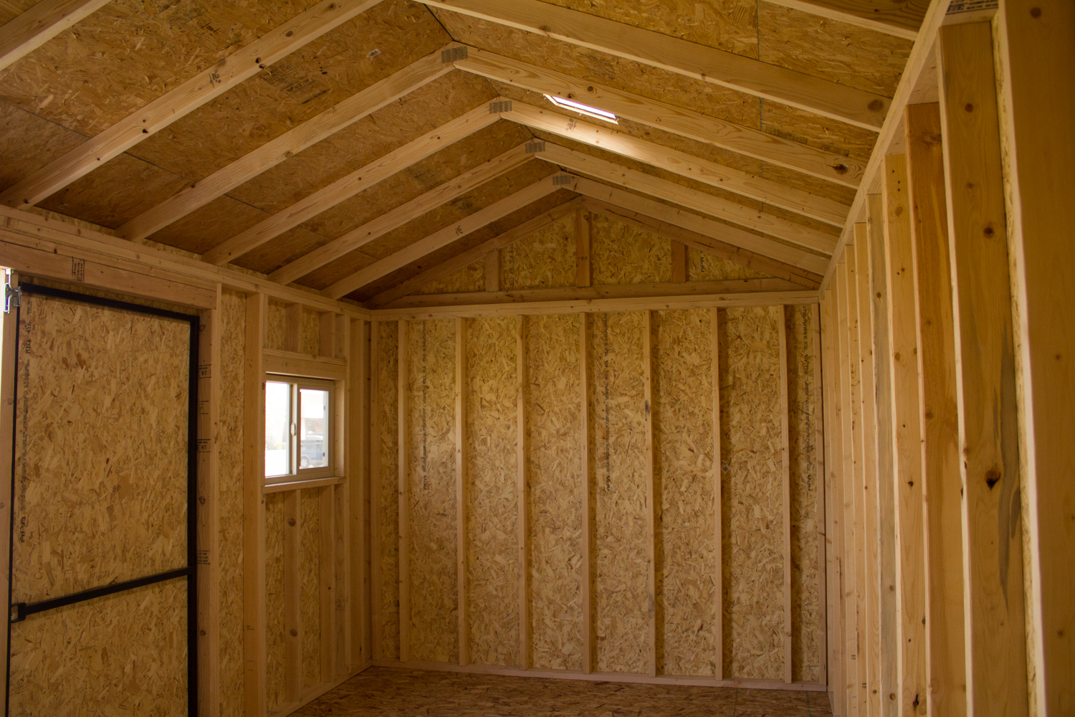
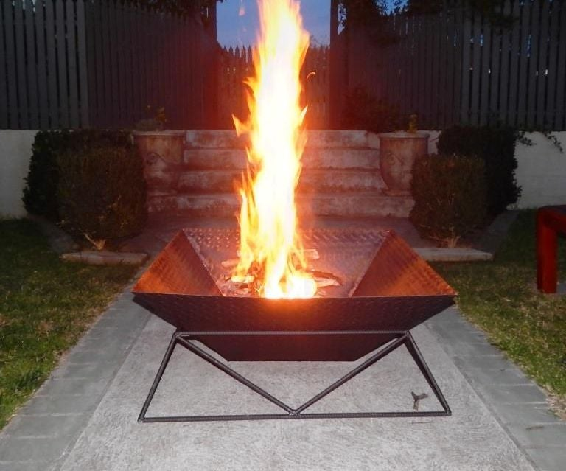
Sample CTS Courses
Bayer’s SPPRF
McIntosh’s SPPRF
Contextual Differences
Closing and Website
Mixed Construction/
Fabrication Shop Class
Project: Framing Shed
Prereqs: CON1010
CON2035: Framing Systems - Floor
CON2045: Framing Systems – Wall
CON2050: Roof Structures 1
CON2060: Doors, Windows & Siding
CON2100: Agri-Structures
CON3060: Doors & Trim
Project: Fire Pit
Prereqs: FAB1010
FAB1040: Oxyacetylene Welding
FAB1048: Semi-Automated/Automated Welding
FAB1100: Fabrication Principles
FAB1110: Bar & Tubular Fabrication
FAB2910: FAB Project B

Slide 22
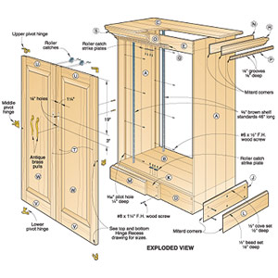
Sample CTS Courses
Bayer’s SPPRF
McIntosh’s SPPRF
Contextual Differences
Closing and Website
Mixed Construction/
Fabrication Shop Class
Project: Cabinet
Prereqs: CON1010, CON1120
CON2130: Furniture – Box Construction
CON2150: Finishing & Refinishing
CON2160: Cabinetmaking – Web & Face Frame
CON2170: Cabinetmaking – Door & Drawer
CON3160: Cabinetmaking – Cabinets & Countertops
CON3170: Cabinetmaking – Layout & Installation
Project: Lathe
Prereqs: CON1010
CON1140: Turning Operations
CON1130: Solid Stock Construction
Project: Concrete
Prereqs: CON1010
CON1180: Mould Making & Casting
CON2020: Concrete Forming
FILLER
Project: Furniture Repair
Prereqs: CON1010, CON1120
CON2150: Finishing & Refinishing
CON3150: Furniture Repair

Slide 23
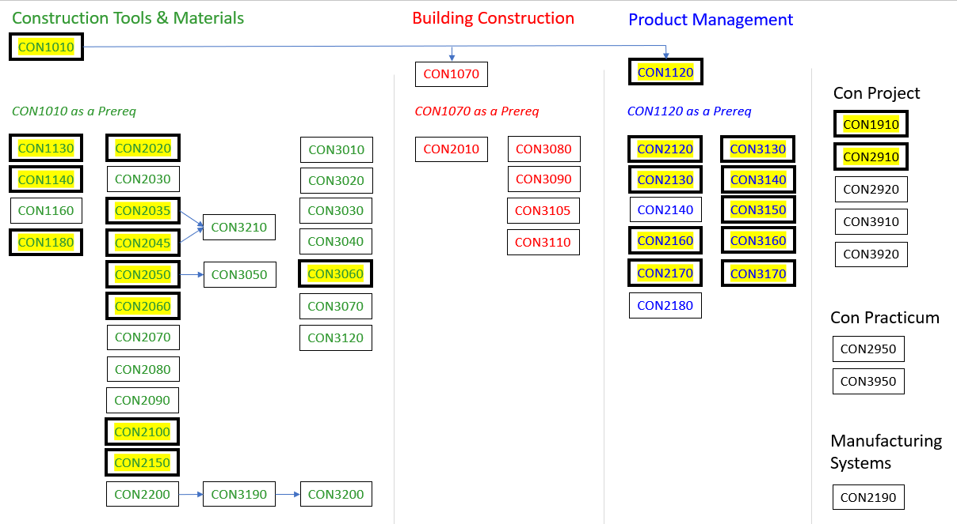
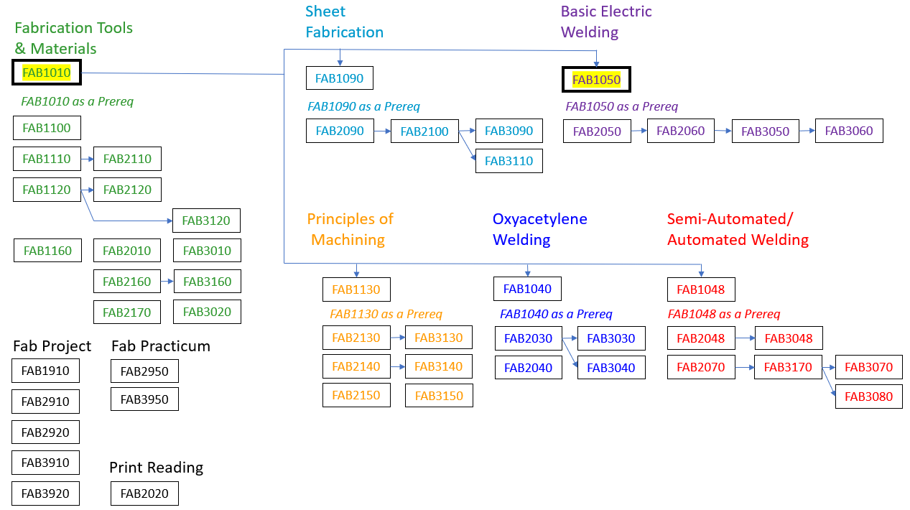
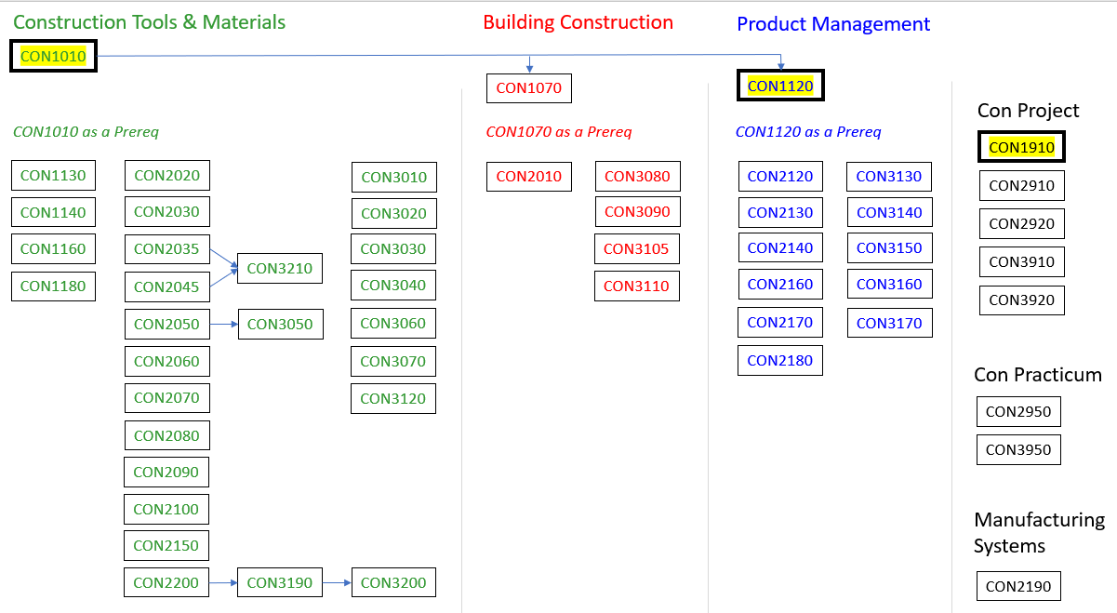
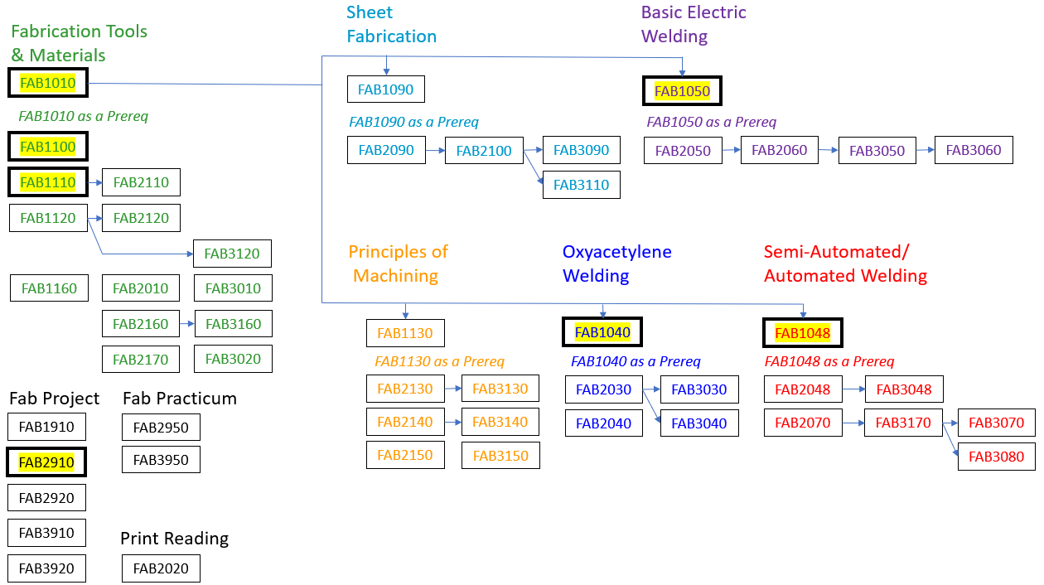
Sample CTS Courses
Bayer’s SPPRF
McIntosh’s SPPRF
Contextual Differences
Closing and Website
Mixed Construction/
Fabrication Shop Class
Project: Wooden Table with Metal Legs
Prereqs: None
CON1010: Construction Tools & Materials
CON1120: Project Management
CON1910: CON Project A
FAB1010: Fabrication Tools & Materials
FAB1050: Basic Electric Welding

Slide 24

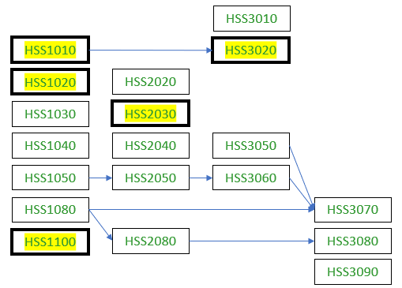
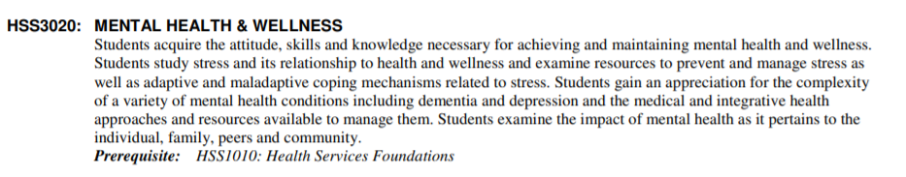
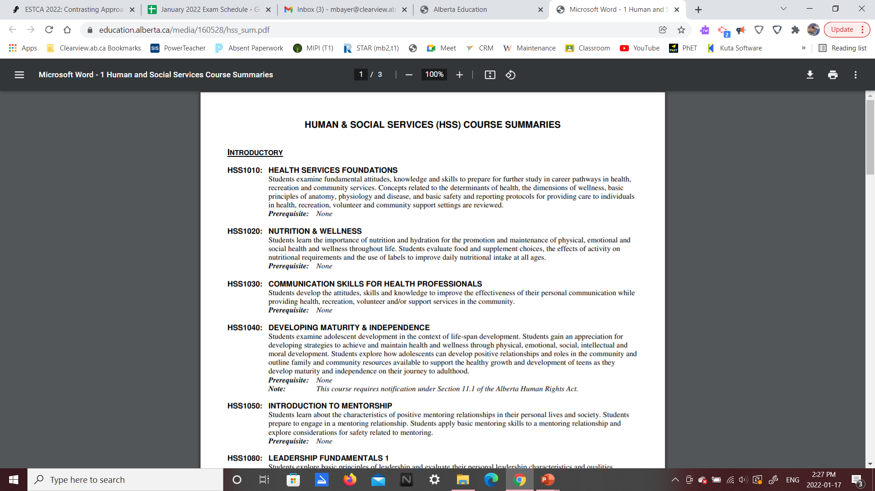
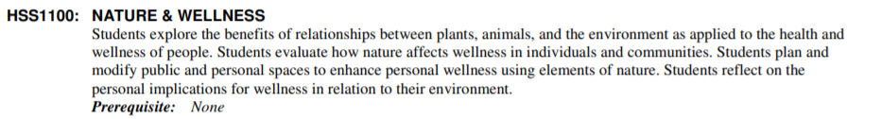
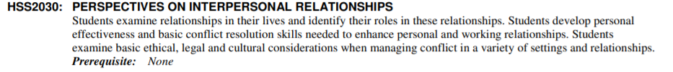
Sample CTS Courses
Bayer’s SPPRF
McIntosh’s SPPRF
Contextual Differences
Closing and Website
Pandemic Response
“Wellness” Class
Theme: Attendance/Assignment Monitoring and Stress Management
Special: Runs year-long, 2 lunch hours per week.
HSS1010: Health Services Foundations
HSS1020: Nutrition & Wellness
HSS1100: Nature & Wellness
HSS2030: Perspectives on Interpersonal Relationships
HSS3020: Mental Health & Wellness

Slide 25
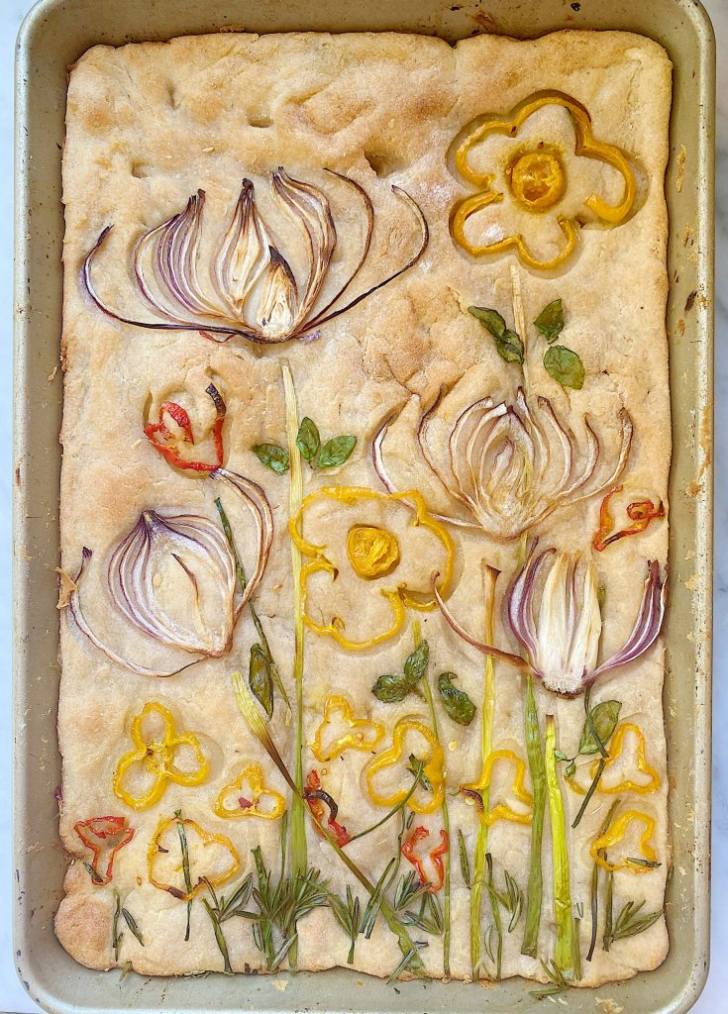

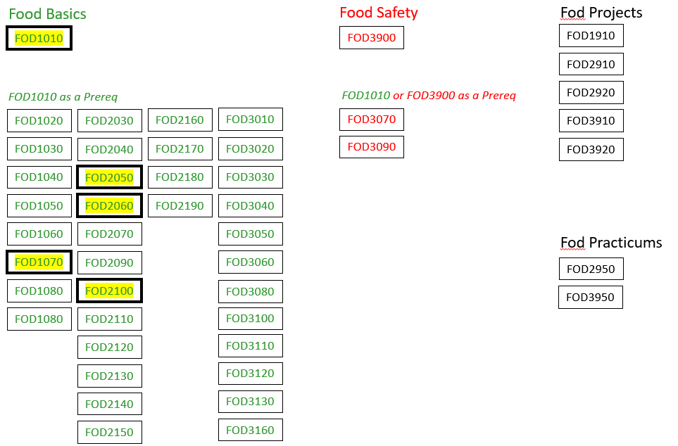
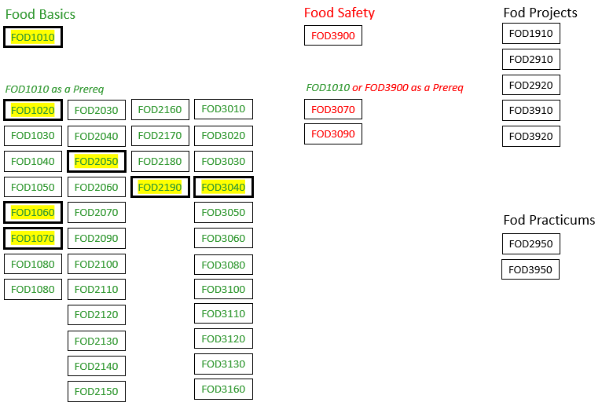
Sample CTS Courses
Bayer’s SPPRF
McIntosh’s SPPRF
Contextual Differences
Closing and Website
Bayer’s Idea
McIntosh’s Idea
Schedule Filler
Foods Class
Theme: Farm to Table
FOD1010: Food Basics
FOD1070: Farm to Table
FOD2050: Bread Products
FOD2060: Milk Products & Eggs
FOD2100: Basic Meat Cookery
Theme: Budget Breads
FOD1010: Food Basics **
FOD1060: Canadian Heritage Foods
FOD1070: Farm to Table
FOD2050: Bread Products
FOD2190: Grains, Legumes, Pulses, Nuts and Seeds
FOD3040: Yeast Products

Slide 26


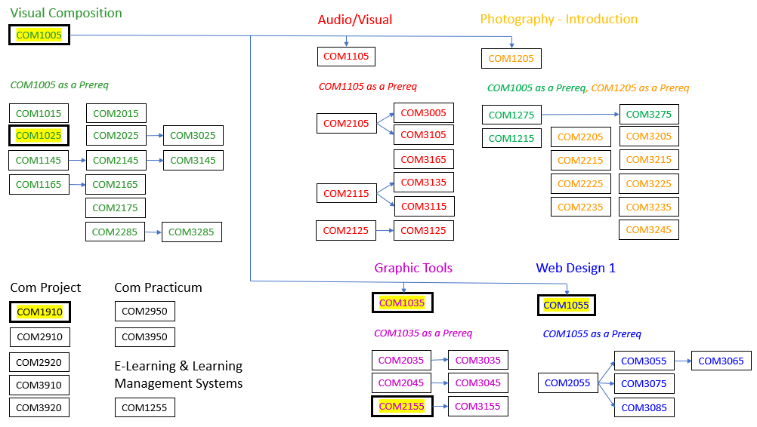
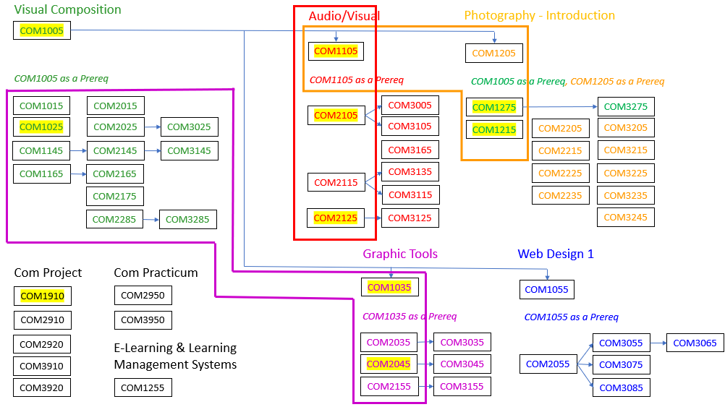
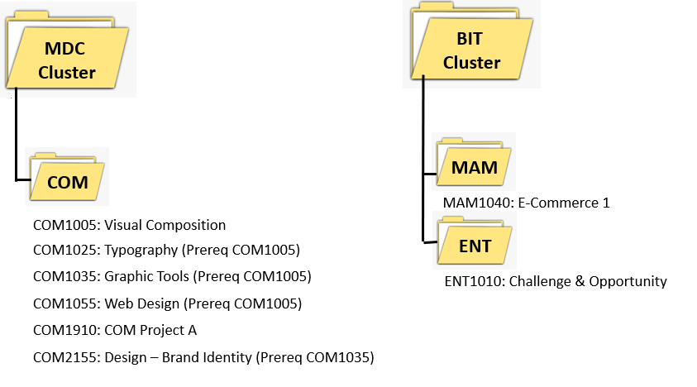
Sample CTS Courses
Bayer’s SPPRF
McIntosh’s SPPRF
Contextual Differences
Closing and Website
Bayer’s Idea
McIntosh’s Idea
Schedule Filler
Comm Tech Class
Theme: Product Website
Special: Variable Credits
Theme: Sports Media
Special: Student Choice of 3 Streams
Print Media Live-Streaming Photography
COM1025 COM1105 COM1105
COM1035 COM2105 COM1215
COM2045 COM2125 COM1275

Slide 27




Sample CTS Courses
Bayer’s SPPRF
McIntosh’s SPPRF
Contextual Differences
Closing and Website
Bayer’s Idea
McIntosh’s Idea
Sports Performance
Theme: Morning Workout Class
Special: Multiple Locations
Theme: REC towards Careers
Special: Assigned Classroom

Slide 28


Bayer’s SPPRF
McIntosh’s SPPRF
Contextual Differences
Closing and Website
Course
Structure

Slide 29



Bayer’s SPPRF
McIntosh’s SPPRF
Contextual Differences
Closing and Website
Pictures
Of
Facilities
Weight Room and Highschool Gym

Slide 30



Bayer’s SPPRF
McIntosh’s SPPRF
Contextual Differences
Closing and Website
Pictures
Of
Facilities
Cardio Room and Junior High Gym

Slide 31





Bayer’s SPPRF
McIntosh’s SPPRF
Contextual Differences
Closing and Website
Course
Outline

Slide 32



Bayer’s SPPRF
McIntosh’s SPPRF
Contextual Differences
Closing and Website
Assignment:
Threaded
Response

Slide 33

Bayer’s SPPRF
McIntosh’s SPPRF
Contextual Differences
Closing and Website
Assignment:
Self-Assessment
Survey

Slide 34


Bayer’s SPPRF
McIntosh’s SPPRF
Contextual Differences
Closing and Website
Assignment:
Optimizing
Personal
Health

Slide 35



Bayer’s SPPRF
McIntosh’s SPPRF
Contextual Differences
Closing and Website
Assignment:
Goal Setting,
Tracking,
Achievement

Slide 36

Bayer’s SPPRF
McIntosh’s SPPRF
Contextual Differences
Closing and Website
Credits
versus
Attendance

Slide 37





McIntosh’s SPPRF
Contextual Differences
Closing and Website
Facilities

Slide 38





McIntosh’s SPPRF
Contextual Differences
Closing and Website
All together now

Slide 39





McIntosh’s SPPRF
Contextual Differences
Closing and Website
Gr 9 – research dance based class and lead
Different Programs
Grades 11/12 – lead, measure, and critique
Gr 10 – combined outcomes and participate

Slide 40



McIntosh’s SPPRF
Contextual Differences
Closing and Website
Pay it forward…
HCS1050
As base credit
REC2015
REC3015

Slide 41


McIntosh’s SPPRF
Contextual Differences
Closing and Website
Grade 10
Grade 11
Grade 12
Mentorship Model - Agility
REC1040 – apply training principles to performance-related components of fitness
Generally serve as group members for older grades to be mentored
Create personal fitness plans after being exposed for 1040, 1050, and 1910
Participate in whole class drills
REC2040 – create, instruct, and provide feedback on an agility/speed/ quickness task
Generally serve as senior group members
Actively lead groups to meet reqs of program
Provide input in and participate whole class drills
REC3030 – advanced assignments on speed & agility
Assessed on performance of whole class drills; then lead them and put own “stamp” on them
Facilitate extended training sessions tailored to their mentor groups
Assess the work of Grade 11s and effectiveness of their plans
Gr 9
No formal curriculum
Generally serve as group members for older grades to be mentored
Present occasional mini lessons (2-3 mins)
Participate in whole class drills

Slide 42



McIntosh’s SPPRF
Contextual Differences
Closing and Website
Academic focus still

Slide 43



McIntosh’s SPPRF
Contextual Differences
Closing and Website
Add-on credits
REC3130:
Officiating
REC2120, REC3120:
Coaching 1 + Coaching 2
REC3140:
Sport and Society
Credit Recovery

Slide 44

McIntosh’s SPPRF
Contextual Differences
Closing and Website
Clear downside

Slide 45
Contextual Differences
Closing and Website
Facilities
Schedule
Student Count
Teacher
Knowledge

Slide 46
Closing and Website
Website: https://albertamathresources.school.blog/
Website: https://kylemcintosh.ca/estca
Ma10C, Ma20-1, Ma20-2
Phys20, Phys30
Sports Performance
ESTCA Convention Presentations
Social 9-12
Sports Performance
ESTCA Convention Presentation
Michael Bayer
Kyle McIntosh

